Slide 1
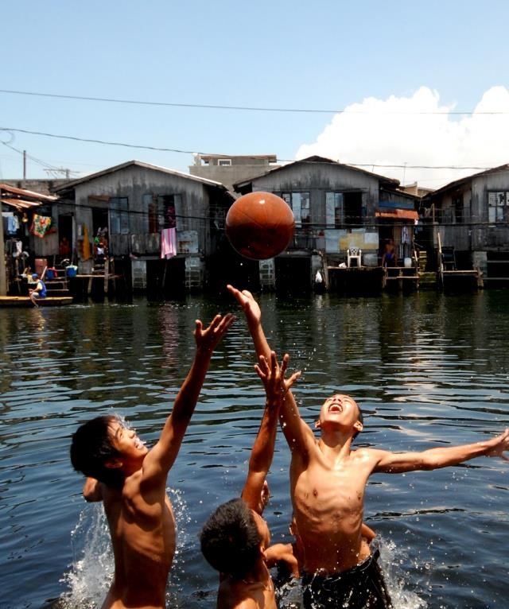

Stakeholder engagement for international water policy
Colin Herron
European River Symposium
May 27th, 2021

Slide 2
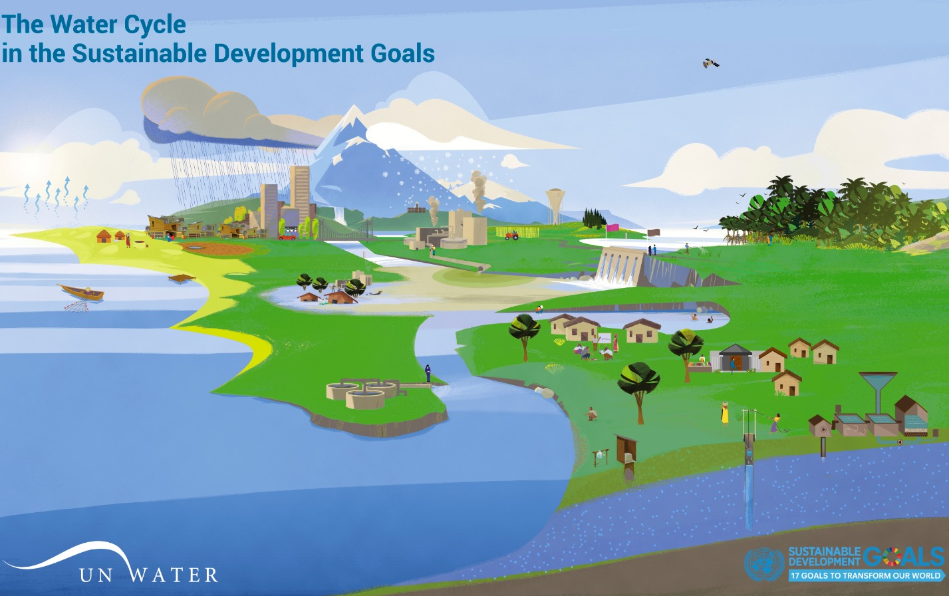
6.5.1 in the SDG 6 context
OUR VISION
A water secure world
SDG 6 “Ensure availability and sustainable management of water and sanitation for all”
6.5
Water manage-ment
6.4
Water use and scarcity
6.6
Eco-systems
6.a and 6.b
Cooperation and participation
6.3
Waste-water and water quality
6.1
Drinking water
6.2
Sanitation and hygiene

Slide 4
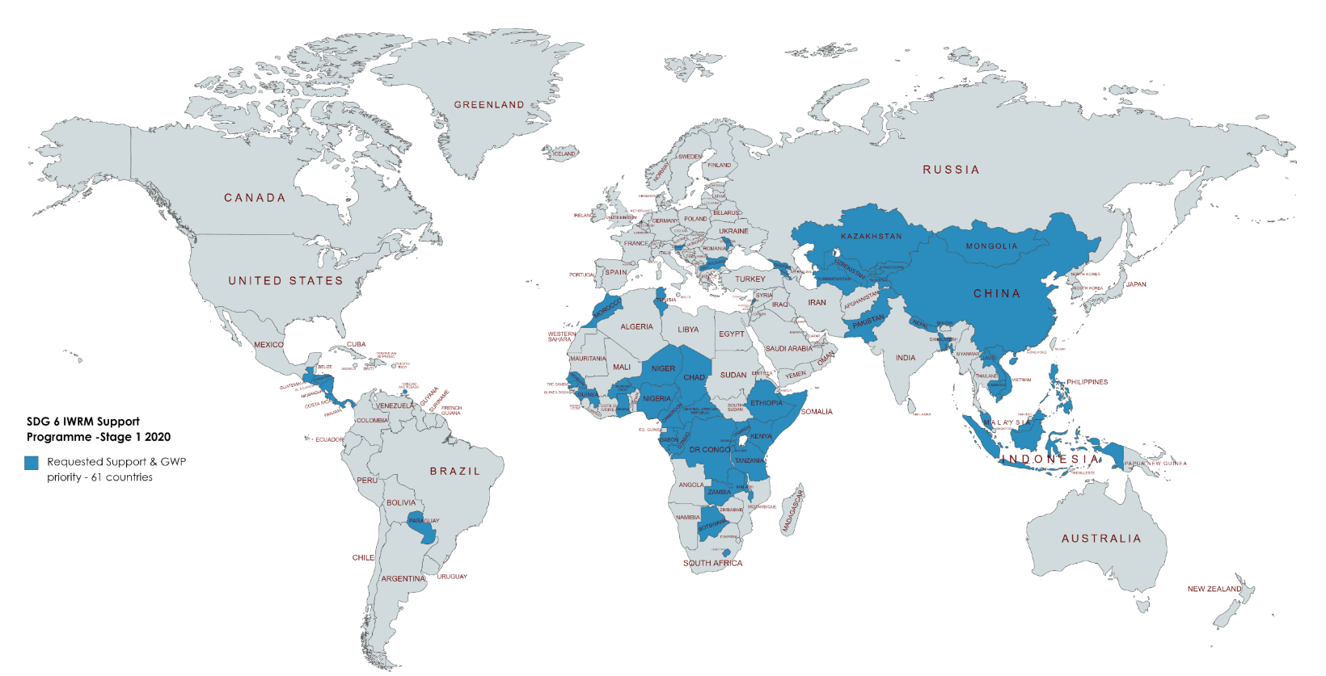
Stage 1, 2020: 61 countries
OUR VISION
A water secure world

Slide 5
OUR MISSION
To advance governance and management of water resources for sustainable and equitable development

Slide 6
Some reflections
Stakeholder engagement is central to IWRM and the Dublin Principles that created the concept (1992), and IWRM is central to the achievement of all water-related SDGs
Input legitimacy comes from (1) stakeholder inclusion (2) procedural fairness (3) consensual orientation and (4) transparency
Stakeholder engagement improves output legitimacy as well as output quality
This allows for diverse stakeholder perspectives to feed into national policy formulation on international commitments

Slide 7


Thank you!
Colin Herron
Global Coordinator, Water Solutions for the SDGs
Global Water Partnership

