Slide 1
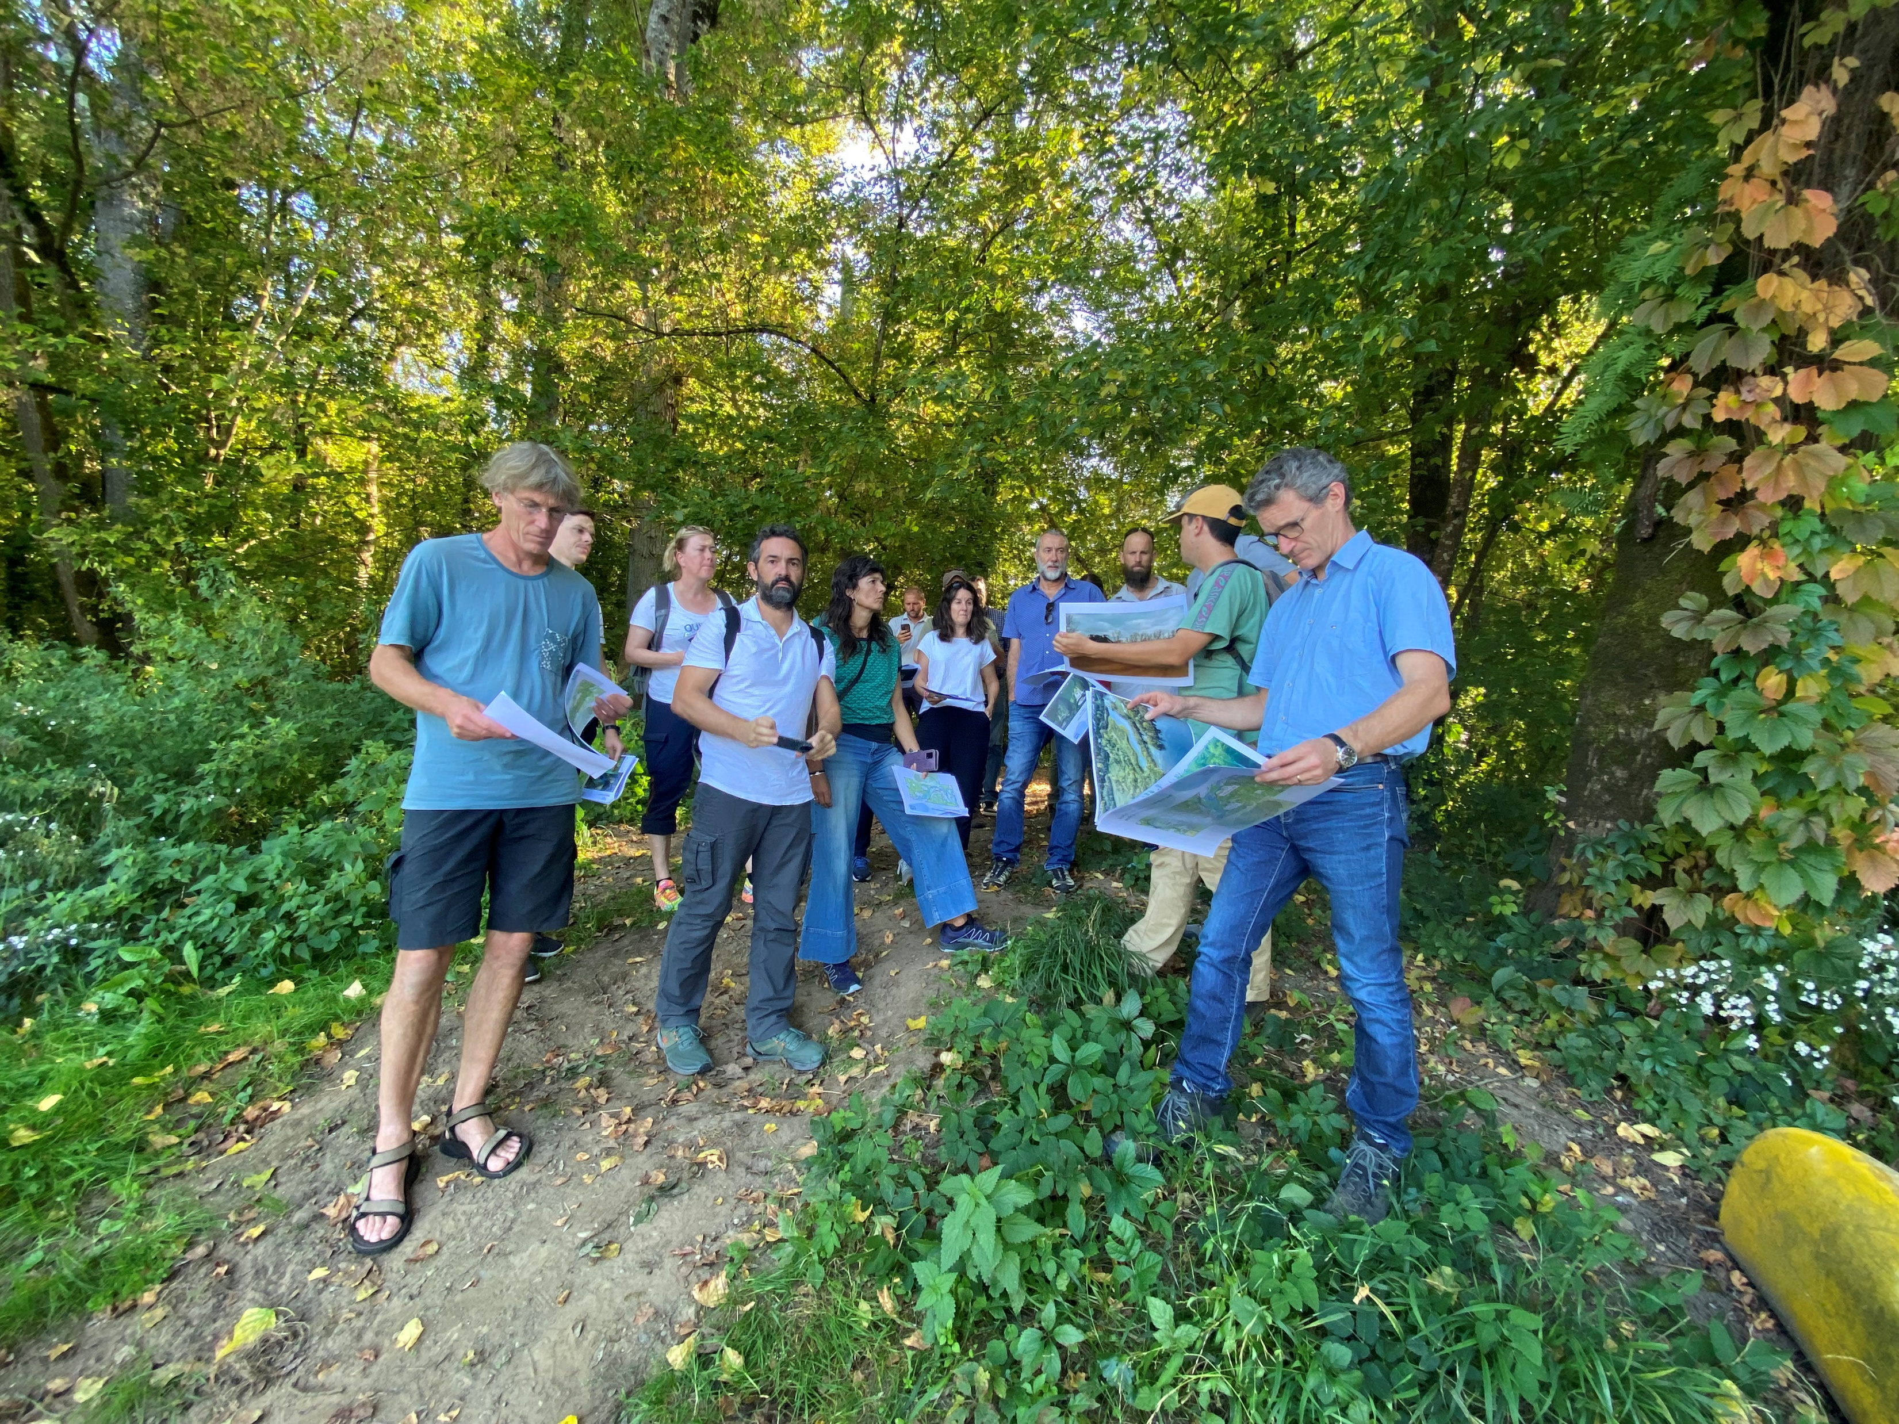
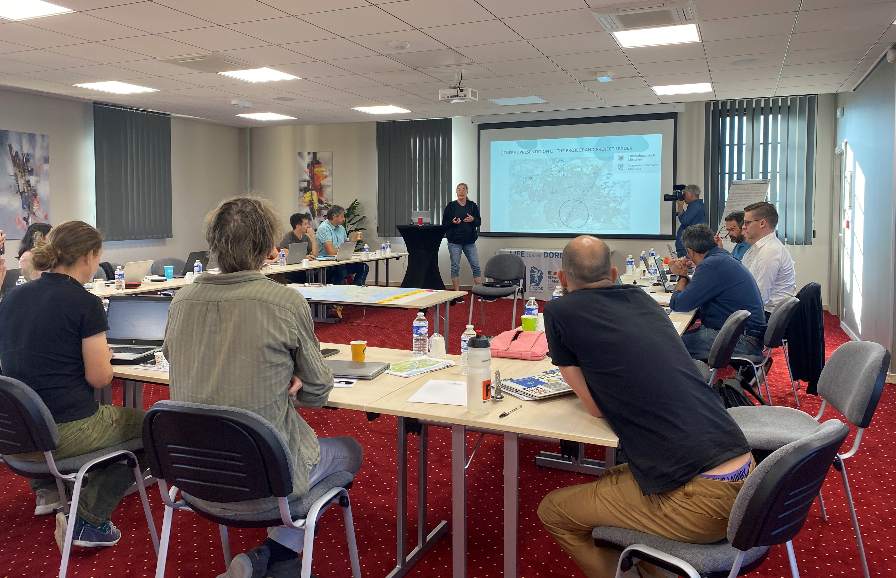
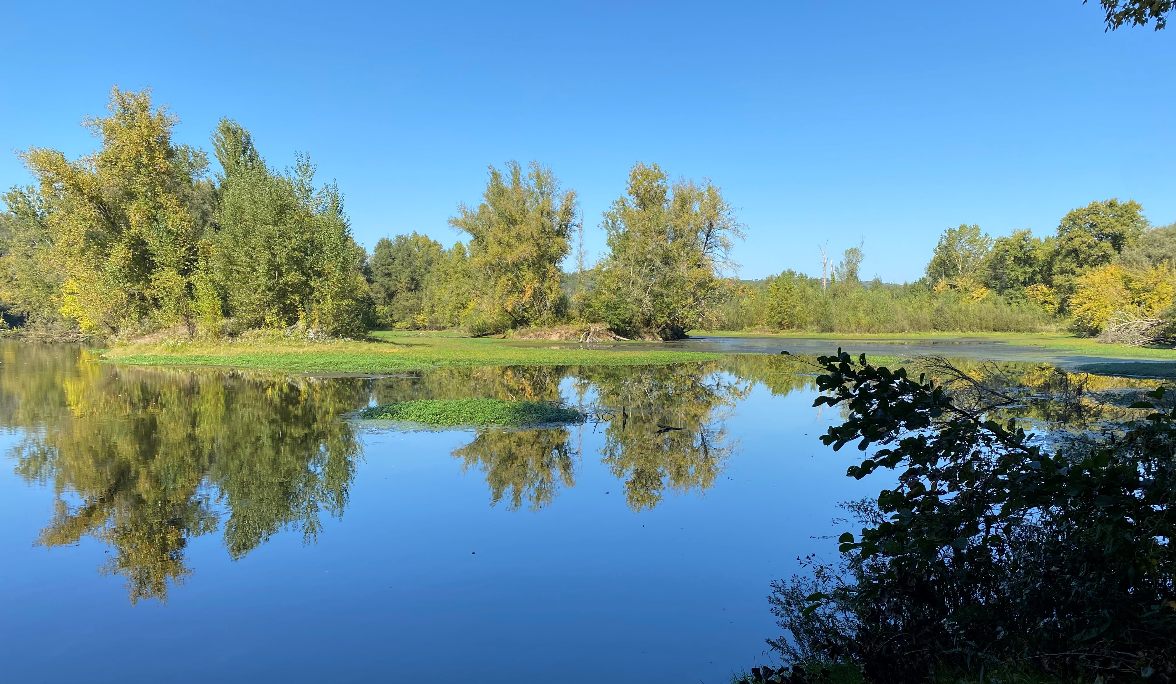
LIFE DORDOGNE INTERNATIONAL WORKSHOP
10-11 October 2023 – Perigord – France

Slide 2
Goals and methodology OF THE PROJECT EXCHANGE AND DISSEMINATION OF BEST PRACTICES IN RIVER MANAGEMENT
Collection of case studies similar to the Dordogne river in a long list including the characteristics, problems and restoration actions
Workshop with the river managers of the 8 rivers aiming to identify and learned about each case and the points in common
Shortlisted of 8 rivers that best represents the similarities with the Dordogne
Life Dordogne Guide:
incorporate the results into the guide: challenges, difficulties, best practices and lessons learned

Slide 3
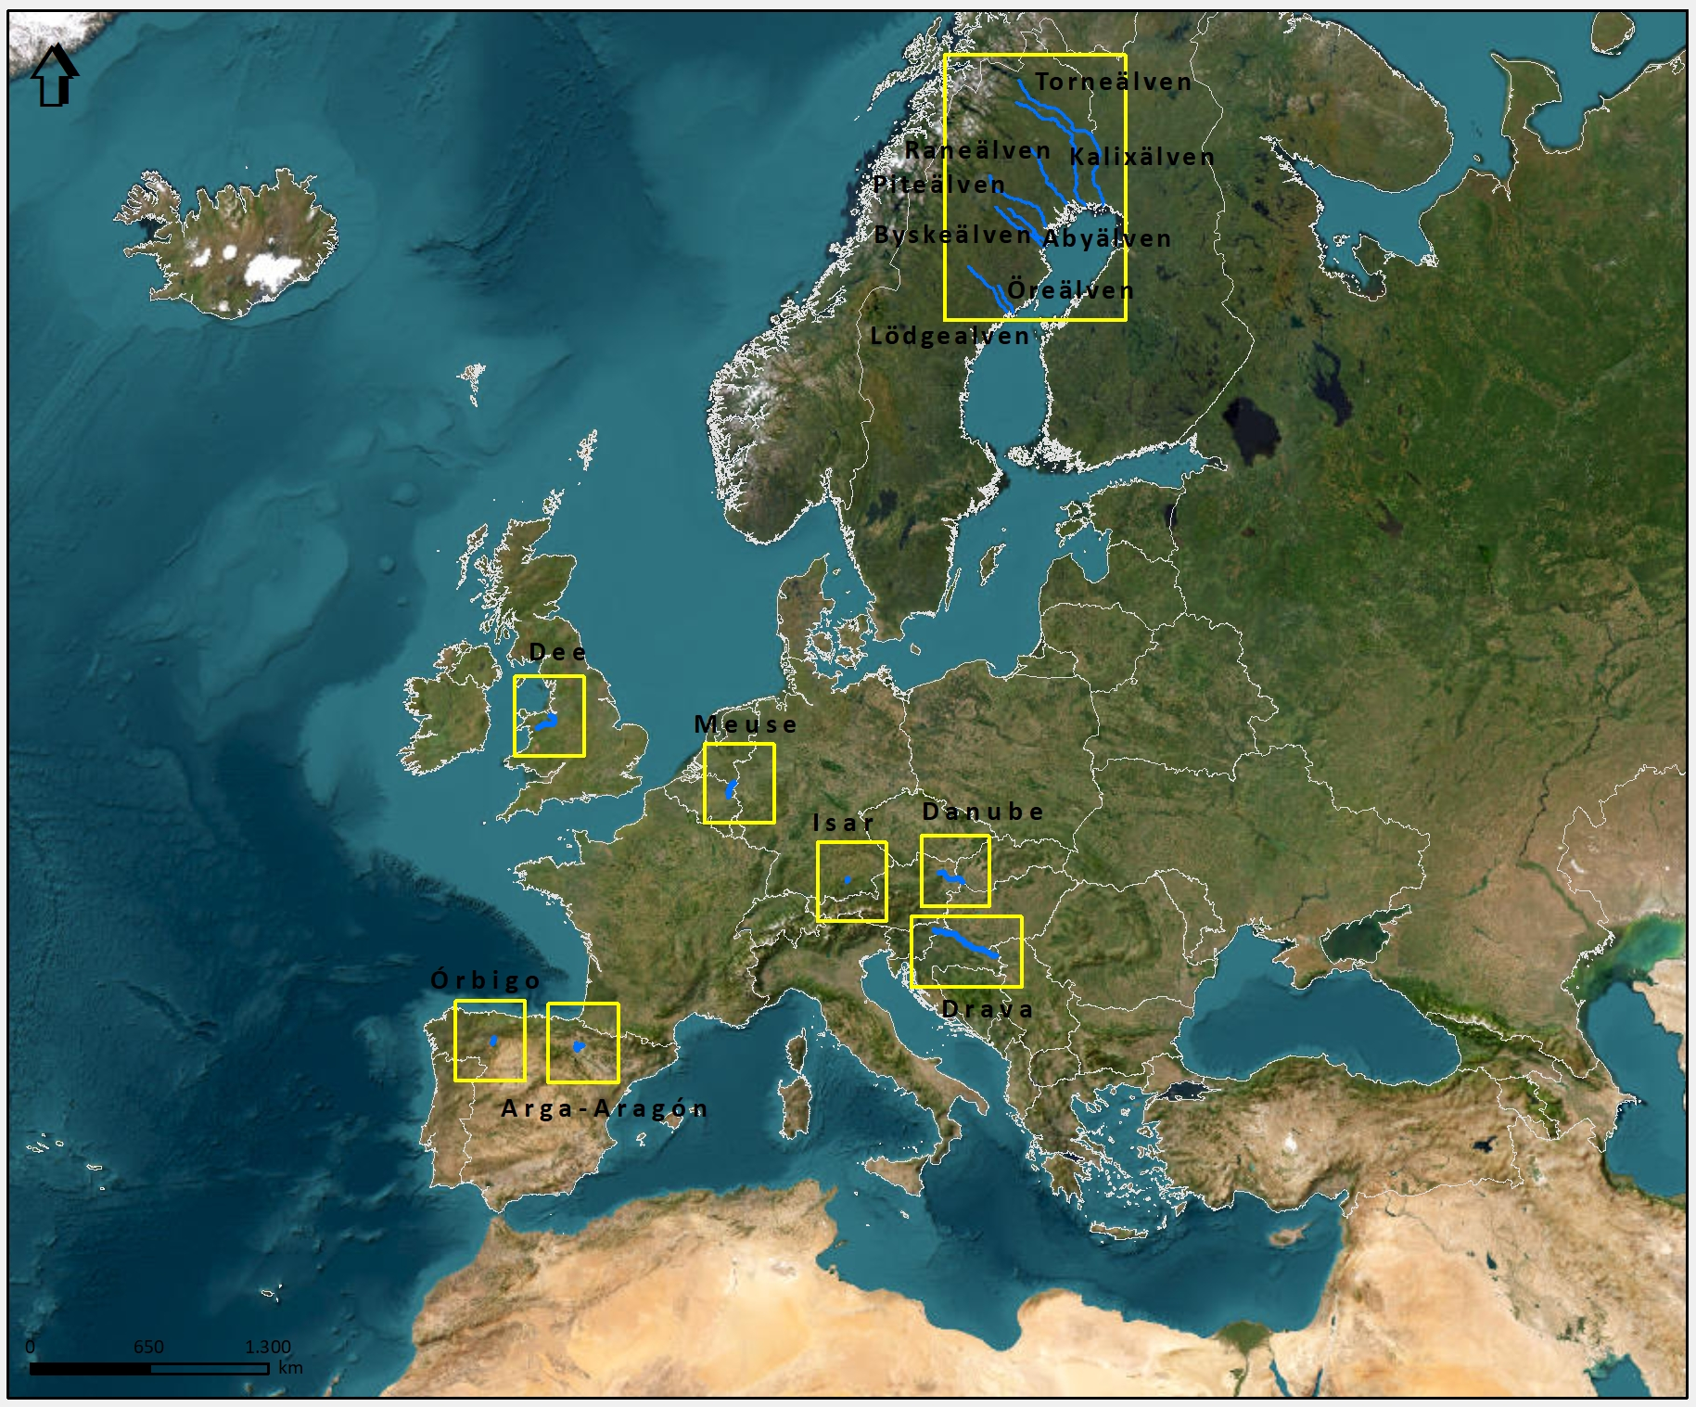
CRITERIA for the SELECTION of the 8 rivers
From the beginning the idea was to select 8 rivers from a first long list.
The long list was 98 projects, based on: shared problems with the Dordogne river, hydromorfological restoration; projects in course and/or finished and monitoring programs
One of the main interests was hydromorphological conditions and collecting experiences of river sediment management
The context had to be a large river with sediment and hydrology problems and large dams or massive gravel extraction.
The sources for finding the projects were:
LIFE projects
INTERREG projects
River wiki, ECRR, Restore, Reform databases
Research databases
National river restoration websites

Slide 4
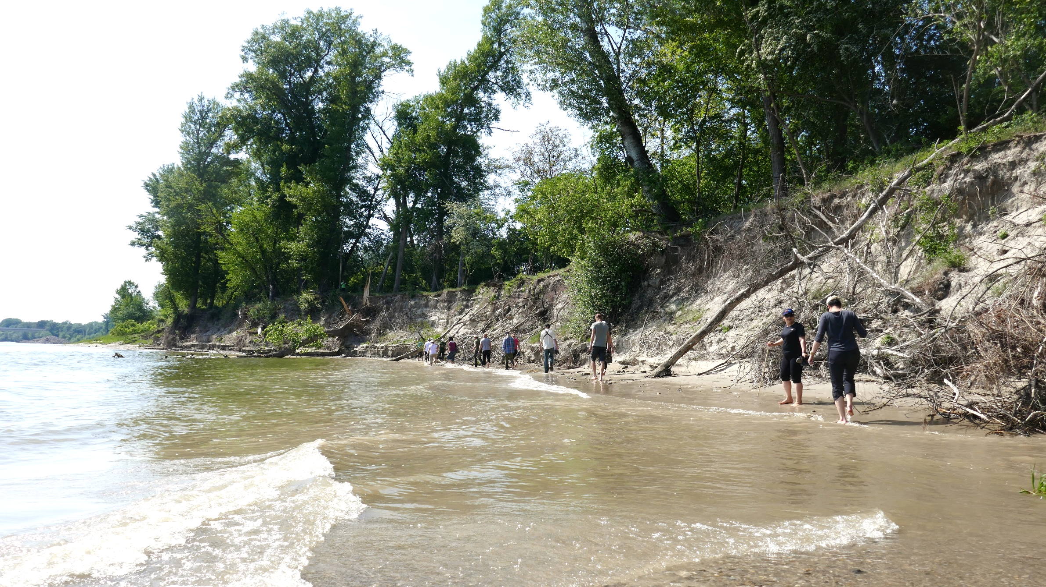
THE 8 RIVER CASES
Thurnhaufen. Source: Viadonau

Slide 5
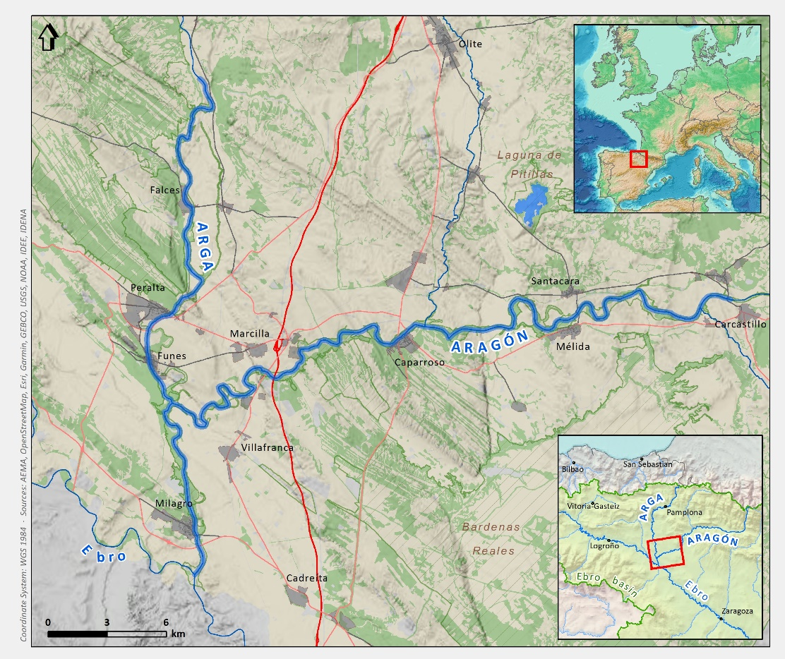
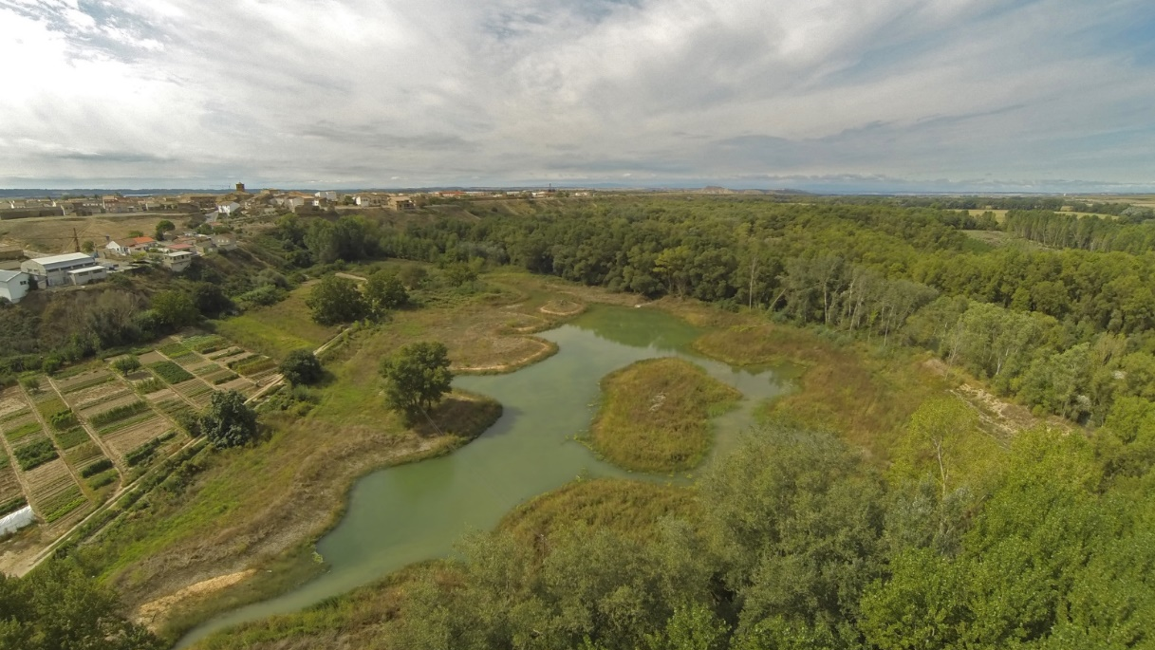
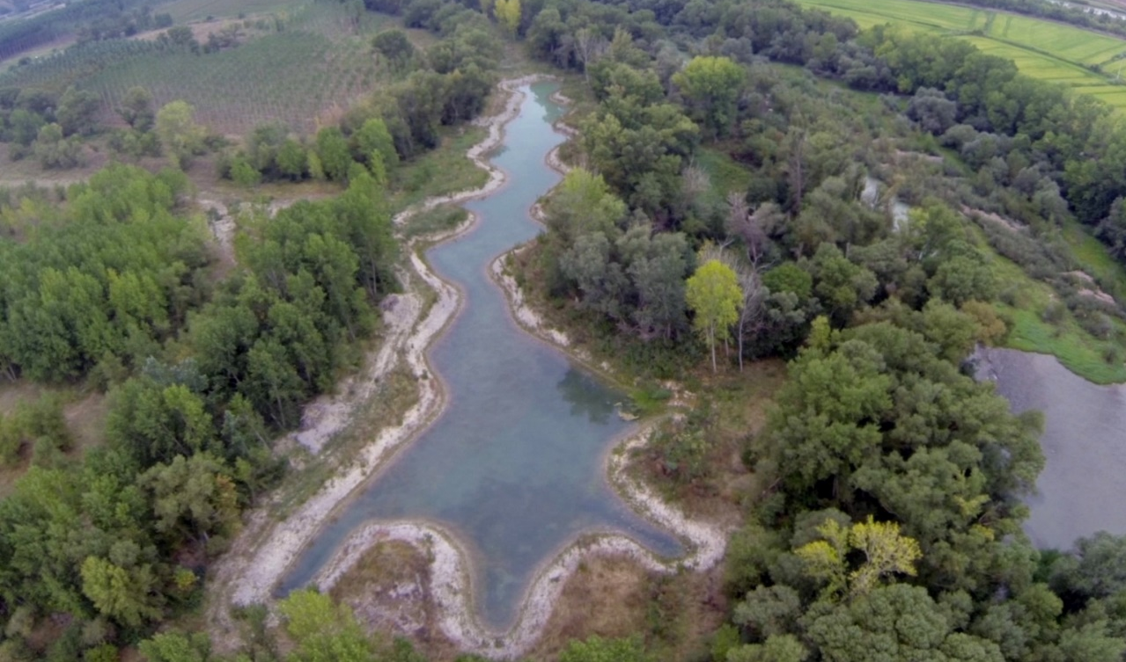
Arga-Aragón Rivers (Spain)
Objective / action | Solution
Recovery of space and river dynamics: Fluvial Territory | - Dikes removal - Breakwater removal - Reactivation of solid transport - Reconnection of oxbows
Improvement of the conservation status of target species | - Creation of habitat for species - Restoration of riparian forests and aquatic habitats
Objective / action | Difficulty
Recovery of space and river dynamics: Fluvial Territory | - Land availability - Lack of trust of the people

Slide 6
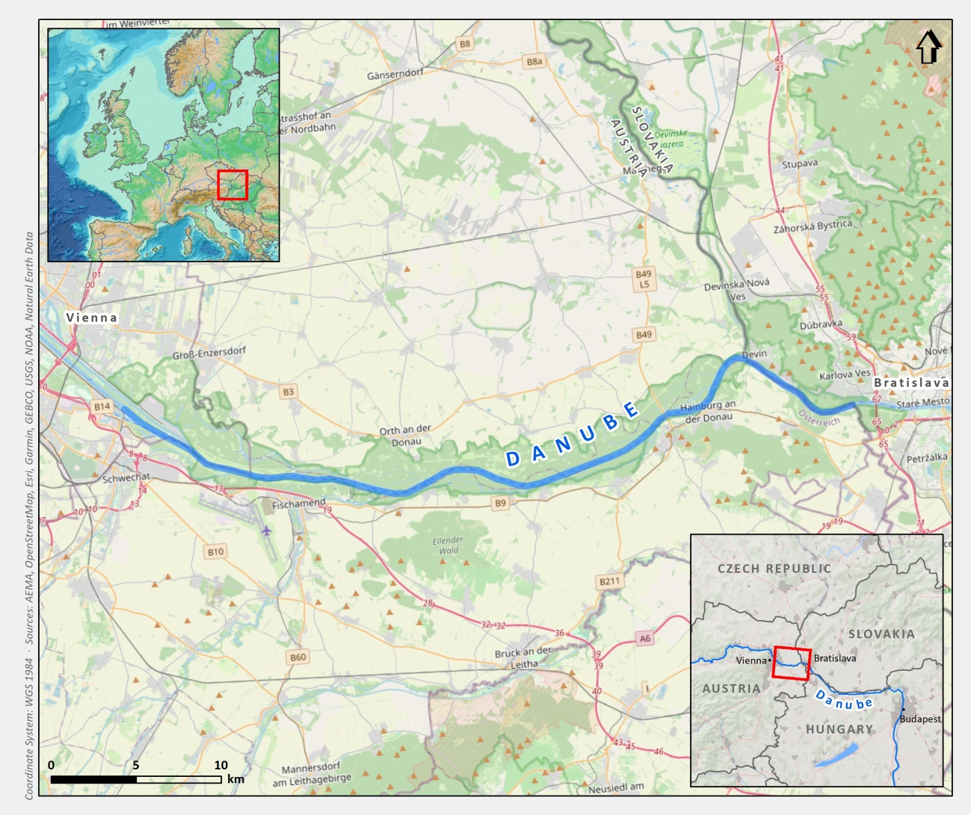
Danube river (Austria)
Objective / action | Solution
Simultaneously meeting the challenges from water management, ecological & nautical perspective | interdisciplinary planning, stakeholder participation
how to achieve ongoing technical & economic optimization and how to deal with uncertainties? | Learning from the river
Counteract river bed degradation and falling (ground) water levels | Dredging of gravel at the end of the section, dumping of gravel at the beginning of the section.
improvement of hydromorphological conditions / lateral connectivity, wave protected habitats | - Low water reconnection of sidearm-systems disconnected in the 19th century to the Danube - Partial removal of the hard bank protection (riprap)
Ecological & nautical optimization of low water regulation taking into account riverbed degradation | innovative groynes, targeted dismantling of regulatory structures
Objective/action | Difficulty
Long-term commitment of stakeholder & politicians incl. funding | Long project duration (beyond a single legislative period), changing governments
Dynamic stability of river bed | - Finding the right mix of measures. Monitoring of «dynamic stability» in the long run. - long-term financing of this maintenance task
Long-term sustainable side arm connections | Sedimentation and falling water levels; smaller & fewer floods

Slide 7
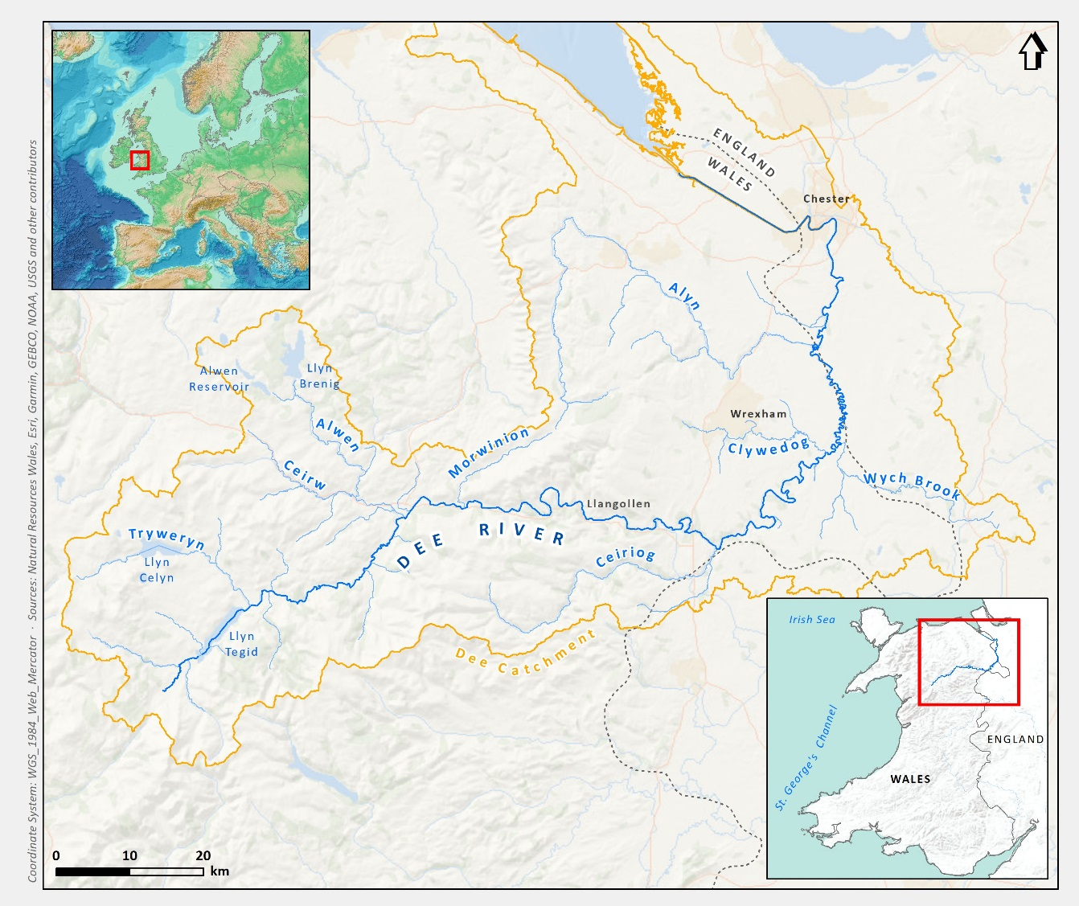
Dee river (Wales)
Objective / action | Solution
Improve spawning ground for migratory fish | Gravel introduction
Improve access to 120km of river for migratory fish | Remove weirs / install fish passes
Reduce nutrient and sediments entering the watercourse | Riparian zone fencing and tree planting
Objective/action | Difficulty
Action C1 – Horseshoe Falls | UNESCO world Heritage
Action C1 – all sites | Permissions
All C Actions | Increasing prices

Slide 8
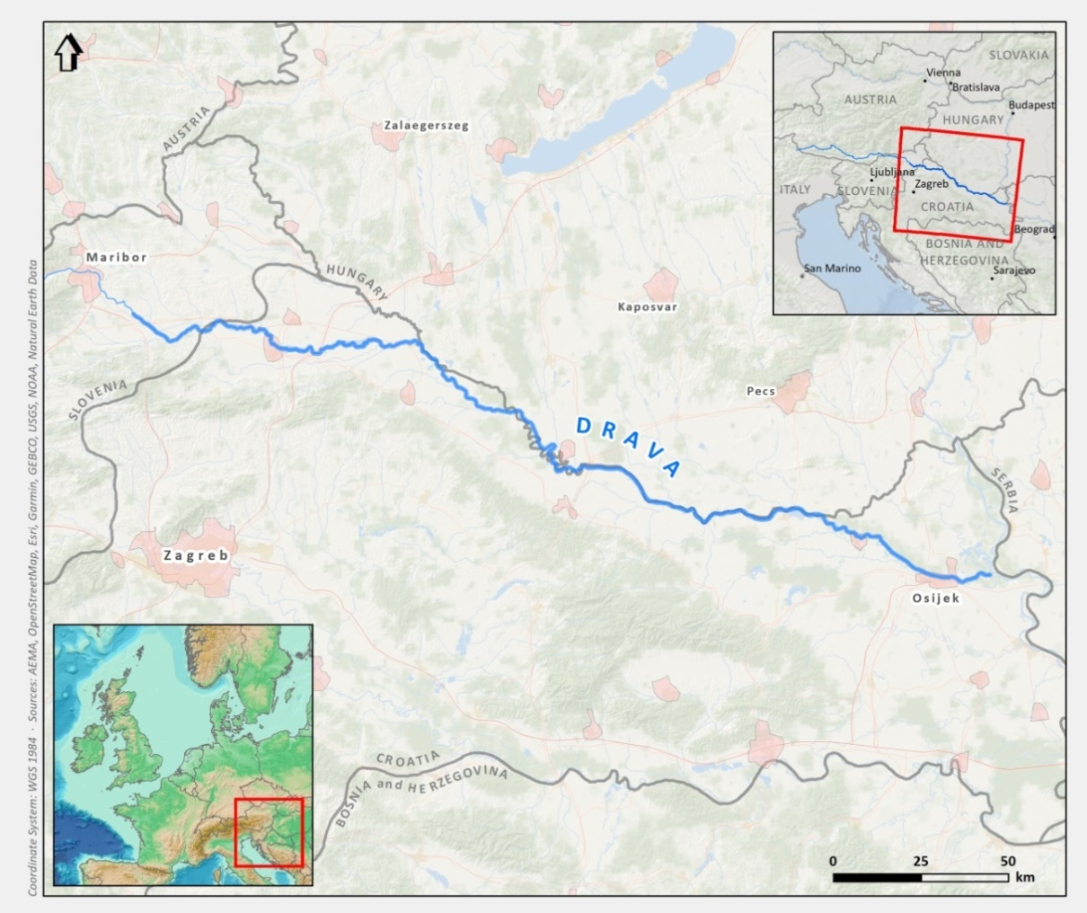
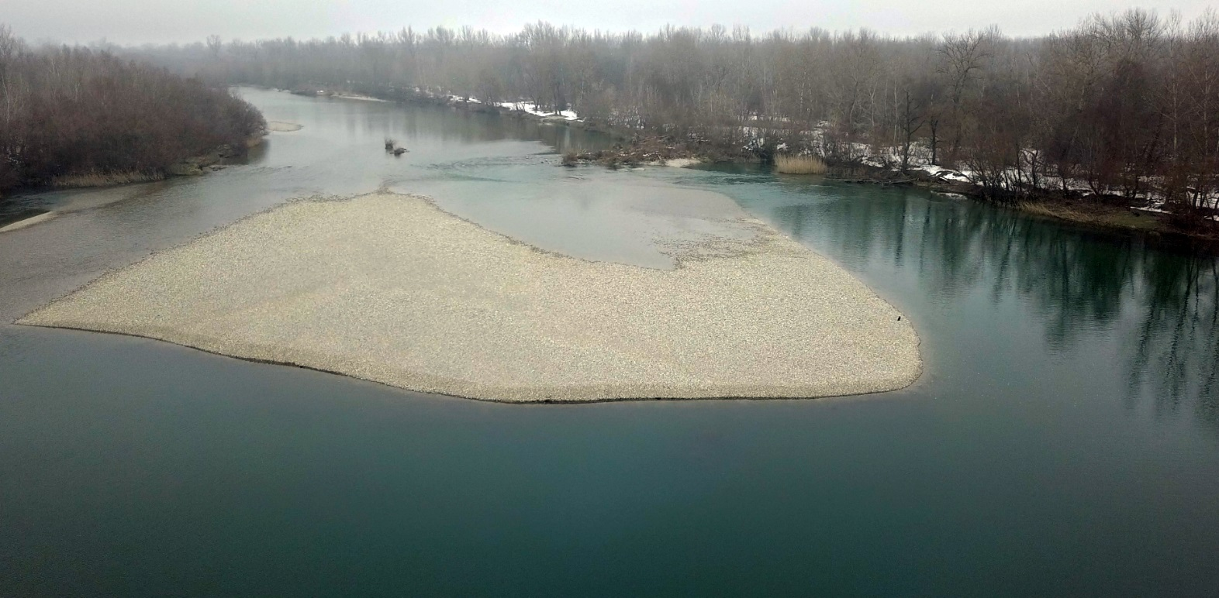
Drava river (Croatia)
Objective / action | Solution
Long lasting EIA procedure | Make sure to have all the necessary surveys
Long lasting planning phase | Need to see what are the possibilities with public procurement improvements
Danger of too long project duration | Fatigue of the project team and designers
Objective/action | Difficulty
C actions | Lack of funds

Slide 9
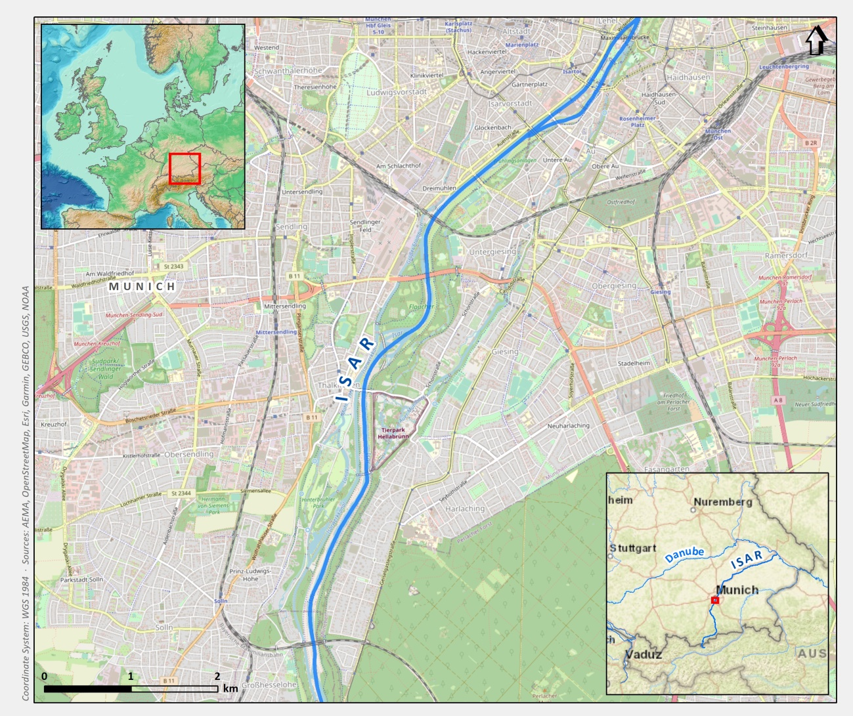
Isar river (Germany)
Objective / action | Solution
Restore bank | - Recover space for morphological processes - Create Backward “hidden“ protection - Removal of concrete bank - Rebuilding banks (flattening, fixing and covering with gravel)‏ - Enabling side erosions processes
Improve aquatic animals life | - Hidden structures for aquatic animals below water level - Fish ladder: bypass for fishes, and playground for kids
Urban design | Urban design next to the river
Objective/action | Difficulty
Flood protection | Sediment deposit within the inner city
recreation | Intensive use / overuse Noise / trash / safety
Natural river landscape | Maintanance / larger scale development vs tweezer care

Slide 10
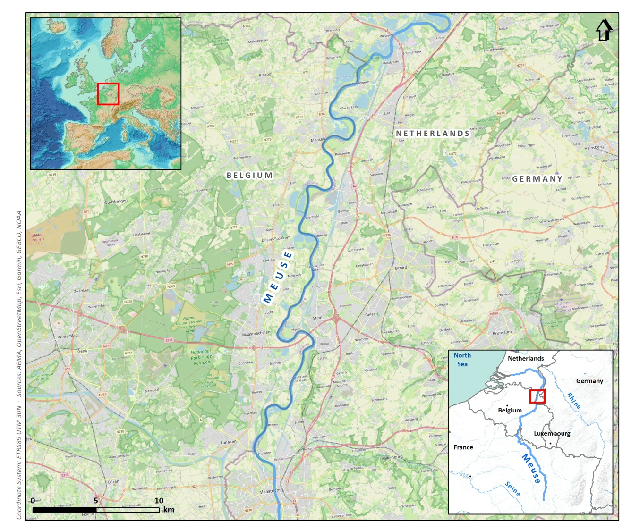
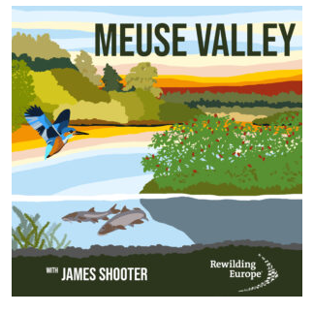
Meuse river (Belgium and Netherlands)
Objective / action | Solution
Graded gravel bed | spontaneous
Species recolonisation | spontaneous
Engineering species | Re-introduction Beaver, Black poplar
Erosion-sedimentation | Bank lowering, removing rip-rap
Ecosystem restoration at scale | Providing room for the river
Gravel augmentation | More room needed
Objective/action | Difficulty
Eroding banks | Infrastructure, agriculture
Natural flow regime | Series of upstream dams
Natural floodplain | Agricultural practices
Gravel augmentation | Flood security
Rewilding Europe Podcast Meuse Valley River Park

Slide 11
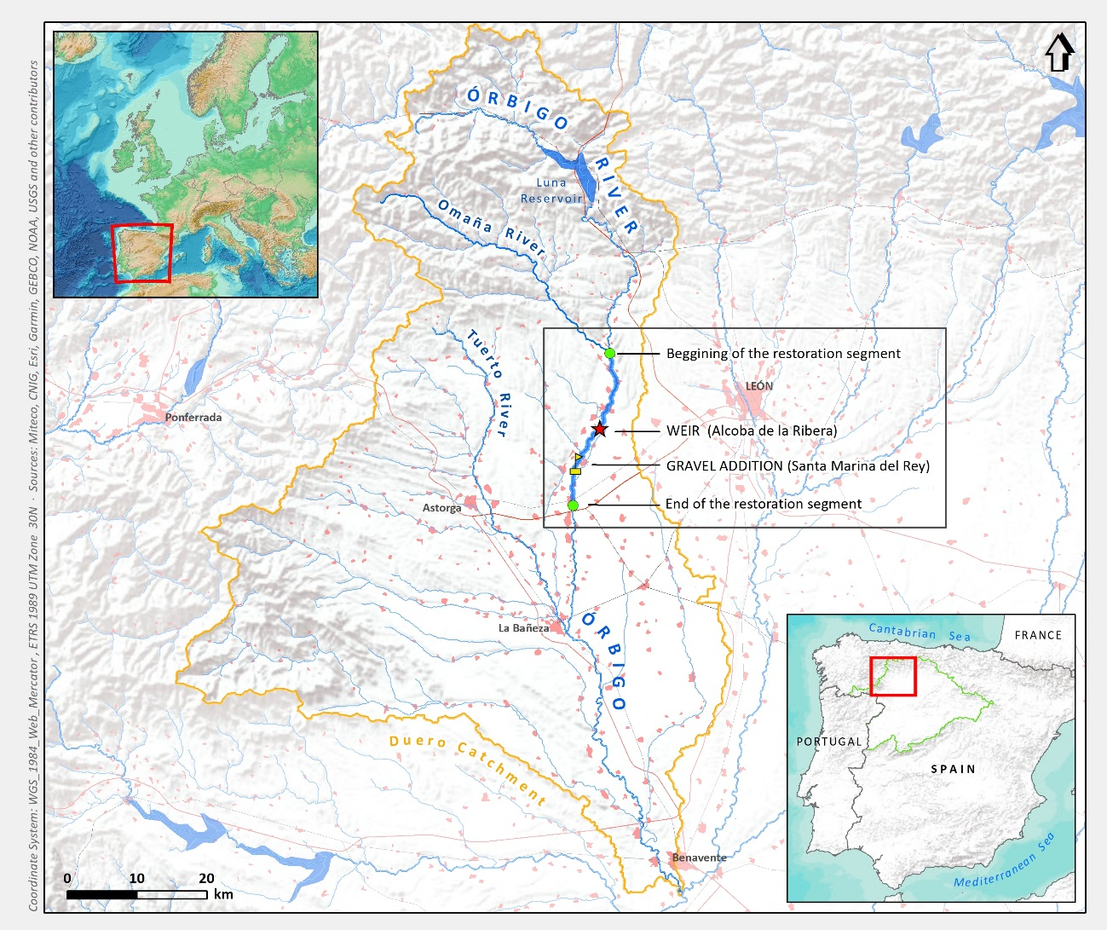
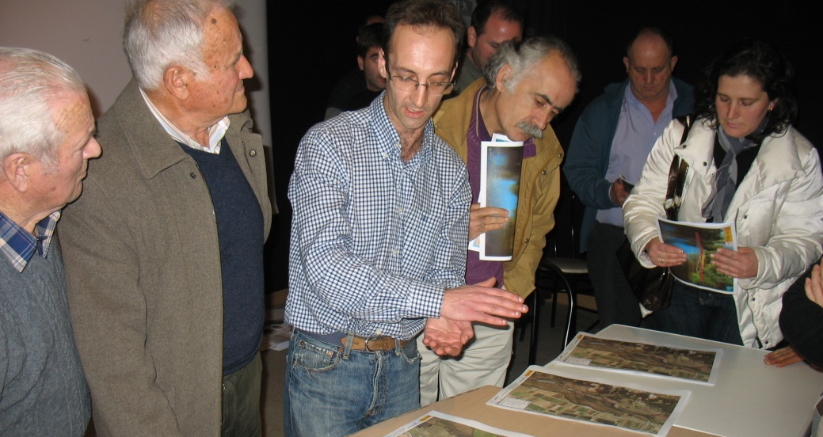
Órbigo river (Spain)
Objective / action | Solution
Economic objectives (Flood management) | Giving space to the river
Hydromorphological recovery | Ripraps and dyke removal, set back of defences, give space to the river, lateral erosion, sediment introduction
Environmental objectives | Habitat diversification
Objective/action | Difficulty
Economic objectives (Flood management) | People
Hydromorphological recovery | People
Environmental objectives | People
“School for Mayors”

Slide 12
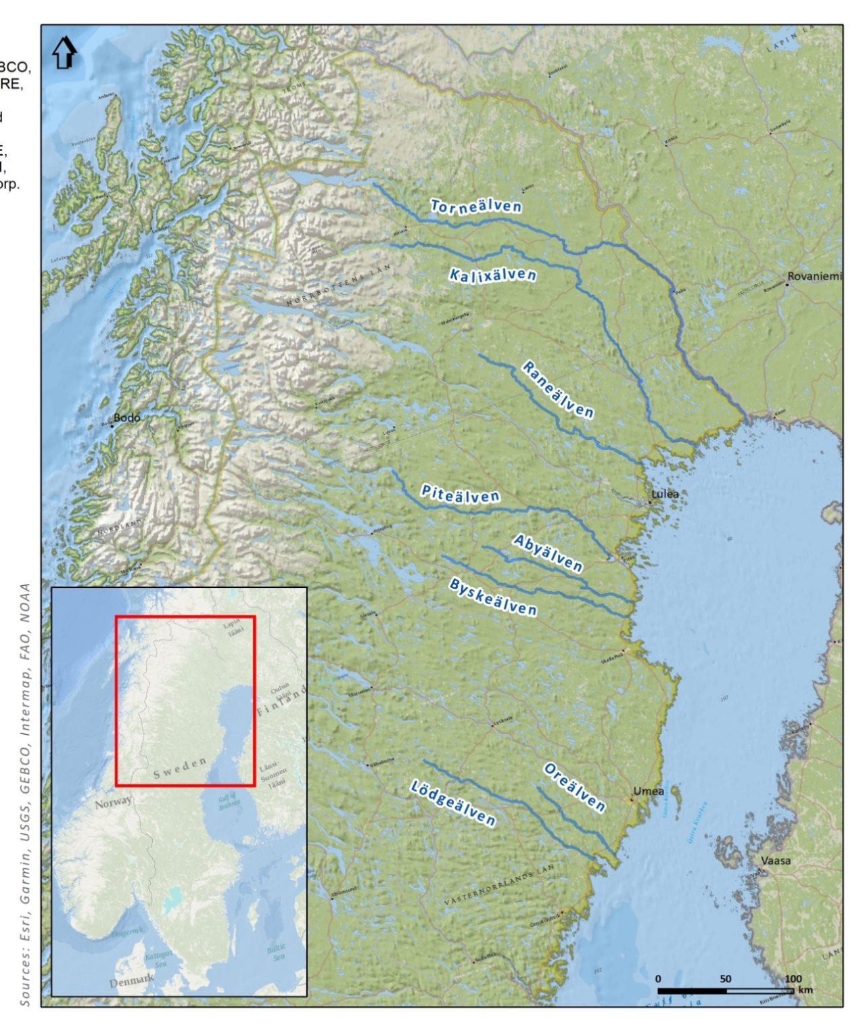
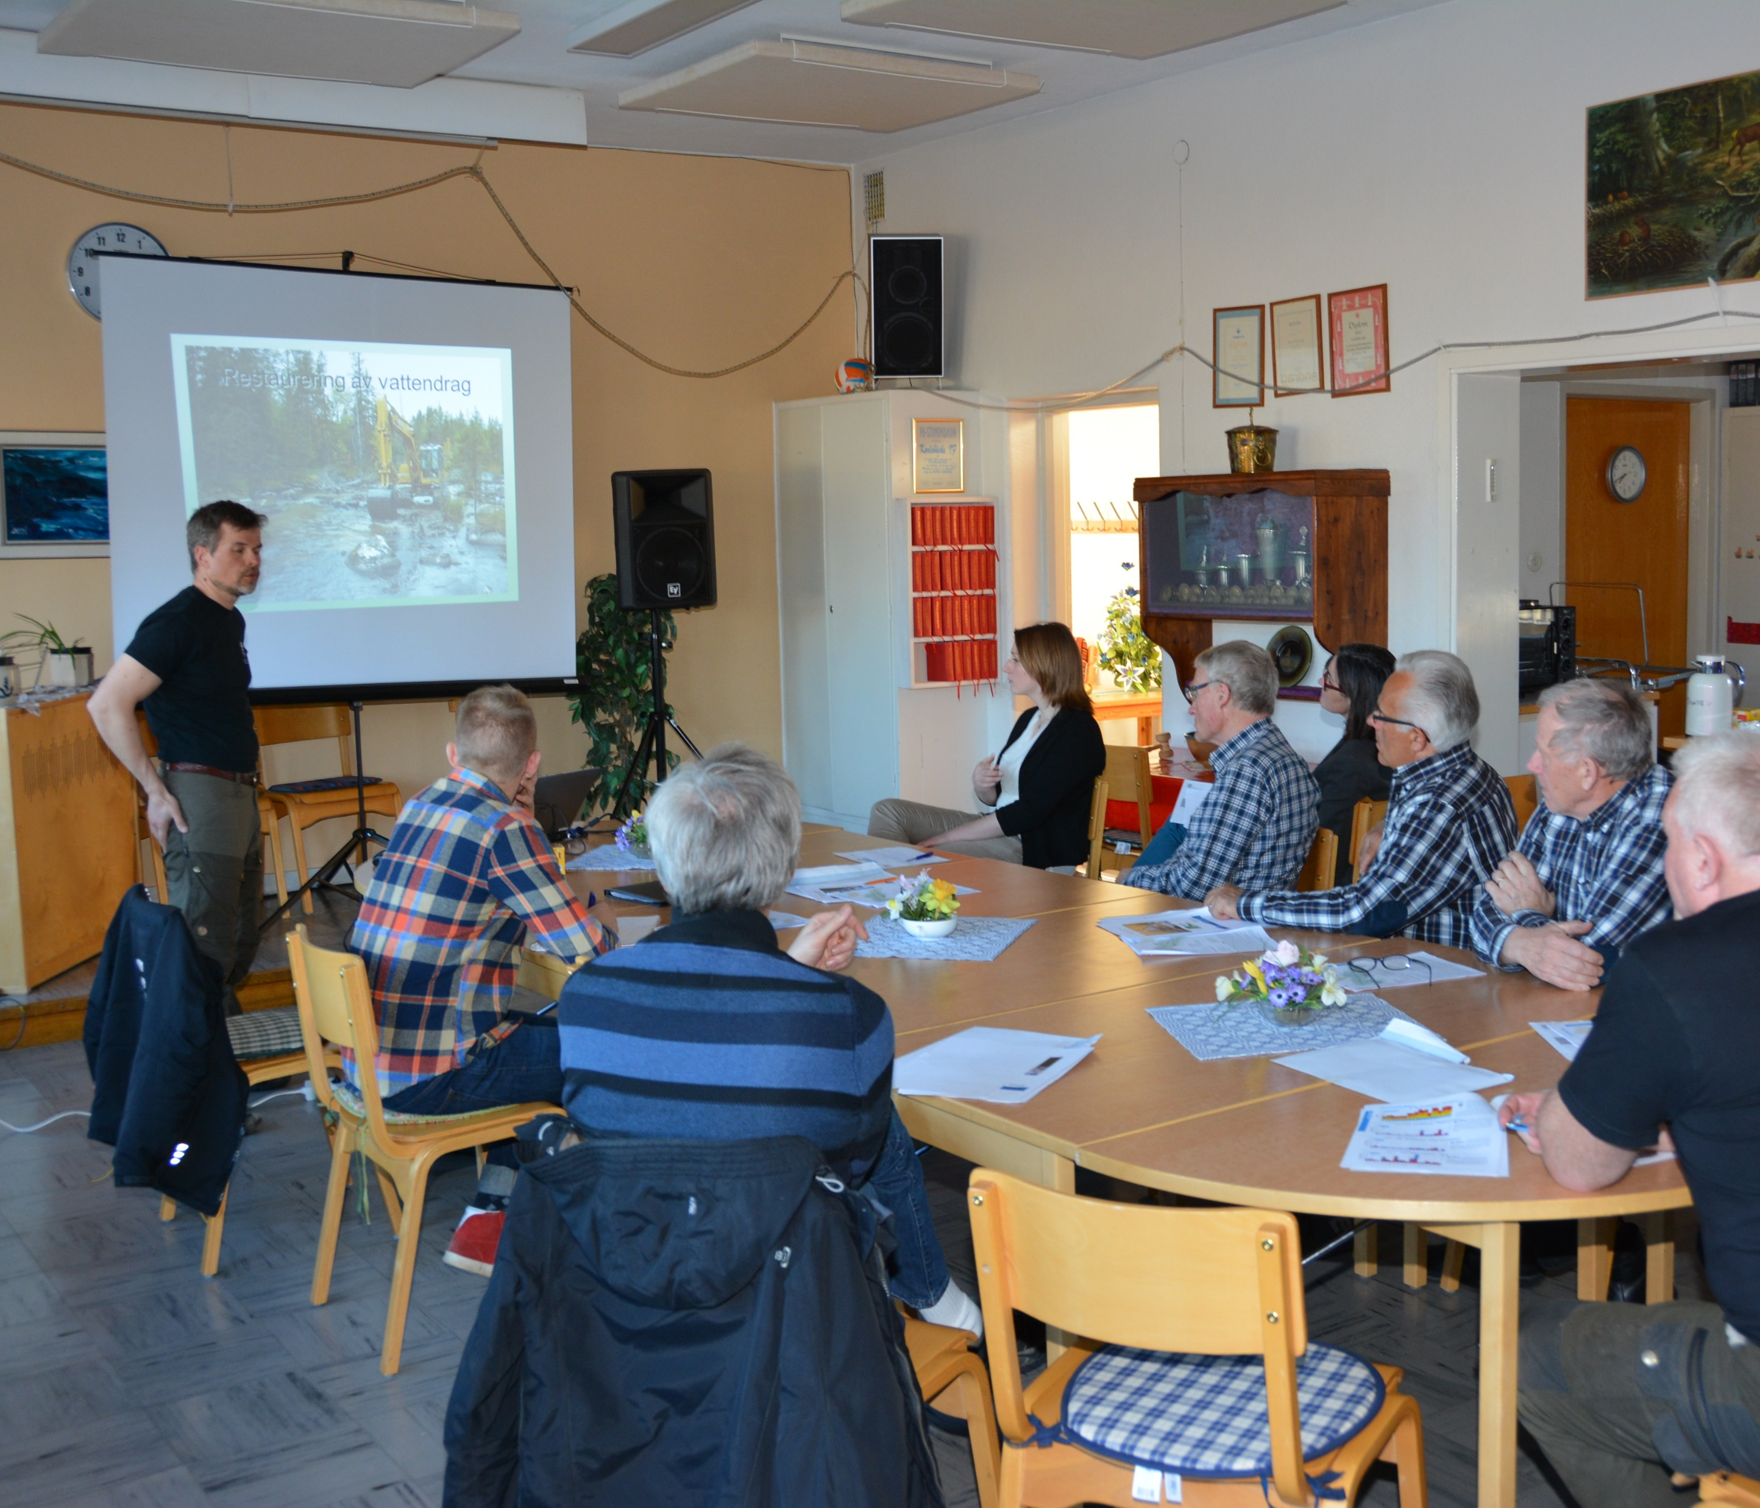
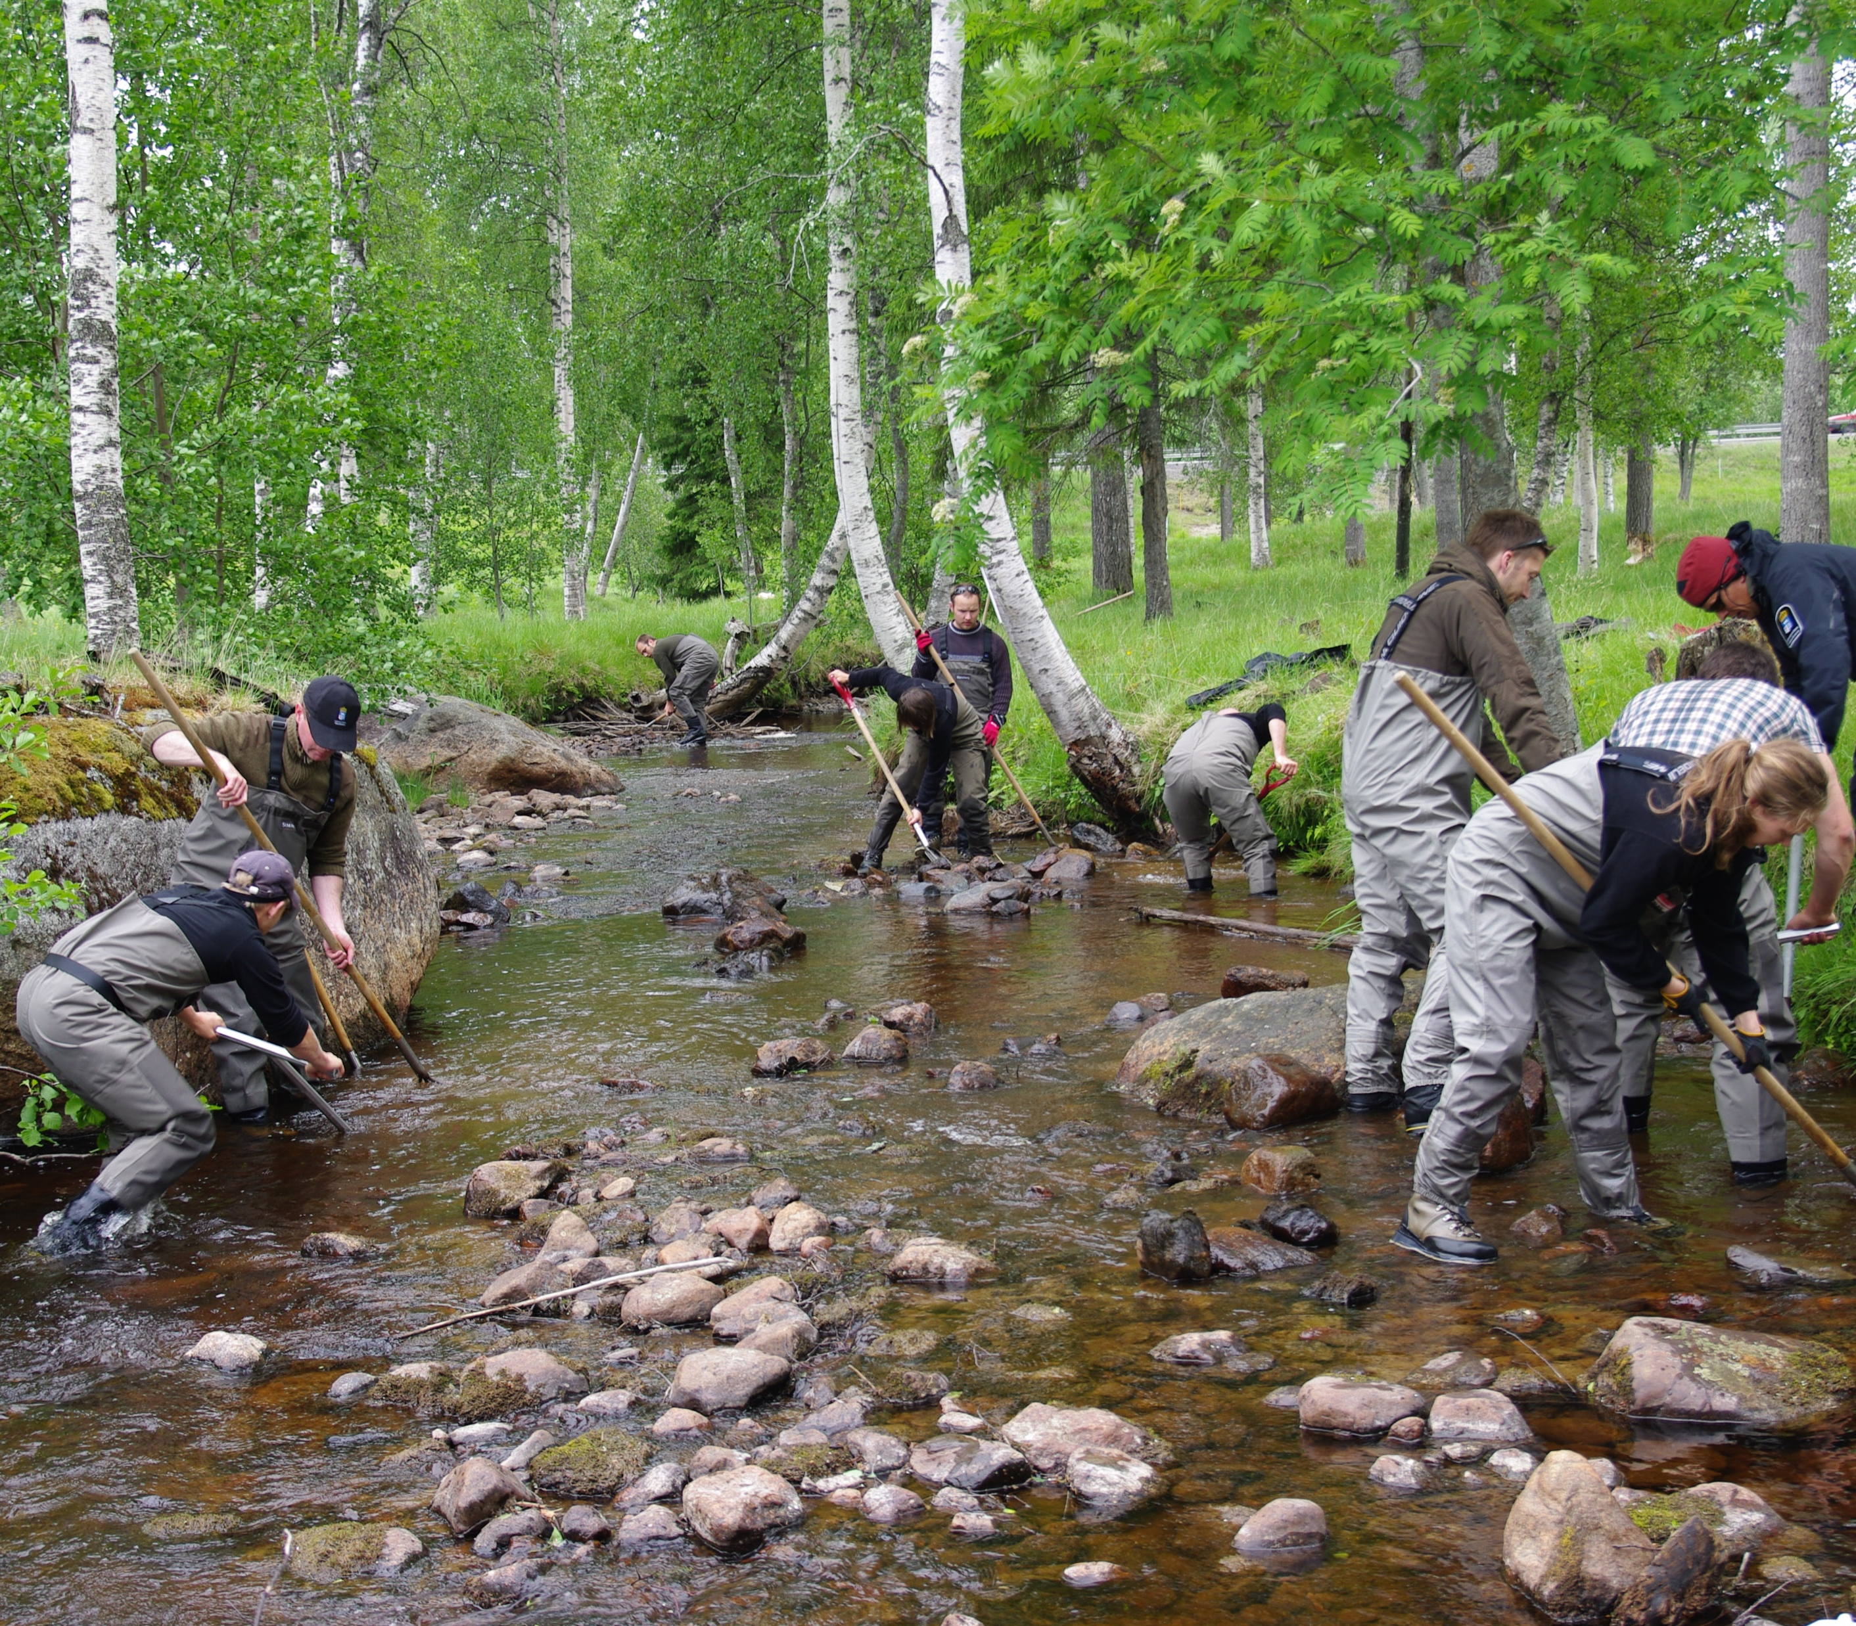
Sweden rivers
Kalixälven, Råneälven, Byskeälven, Piteälven, Åbyälven and Lögdeälven in ReBorn project. Ammerån, Rörströmsälven and Åreälven, Ore and Mo Rivers in Ecostreams project
Objective/action | Difficulty
Restoration permits | Some Landowners (most landowners are very cooperative and positive)
Conflicting interests | - Anglers against restoration as their favurite spot disappears - Forestry lobby - Cultural history (remnants from floating era)
Sustainability in knowledge and ability | Among personnel and entrepreneurs.

Slide 13
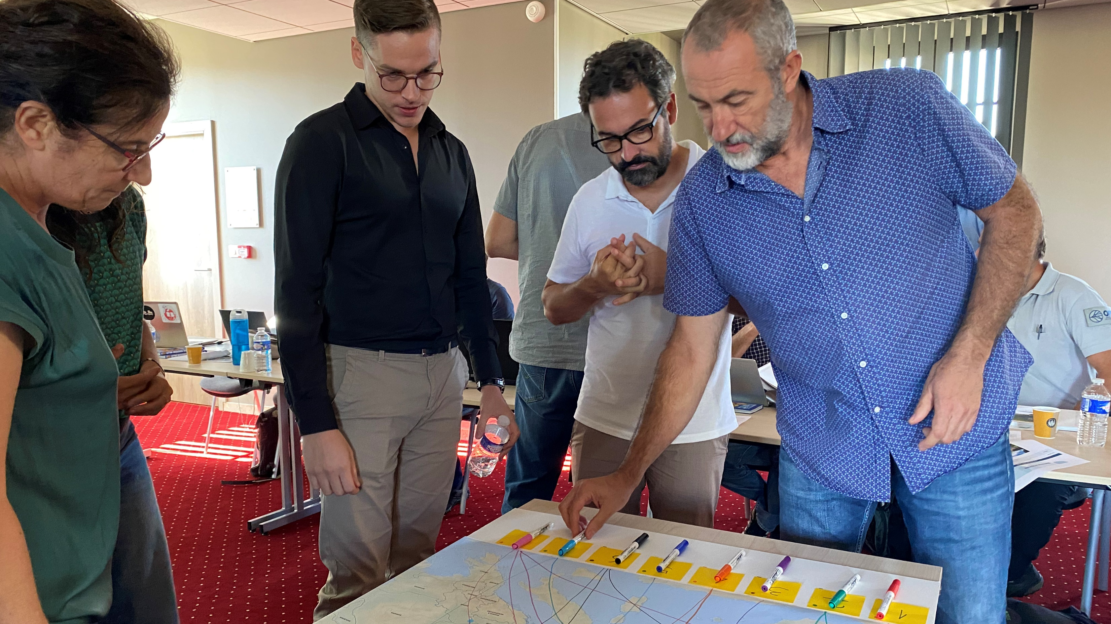
THE WORKSHOP

Slide 14
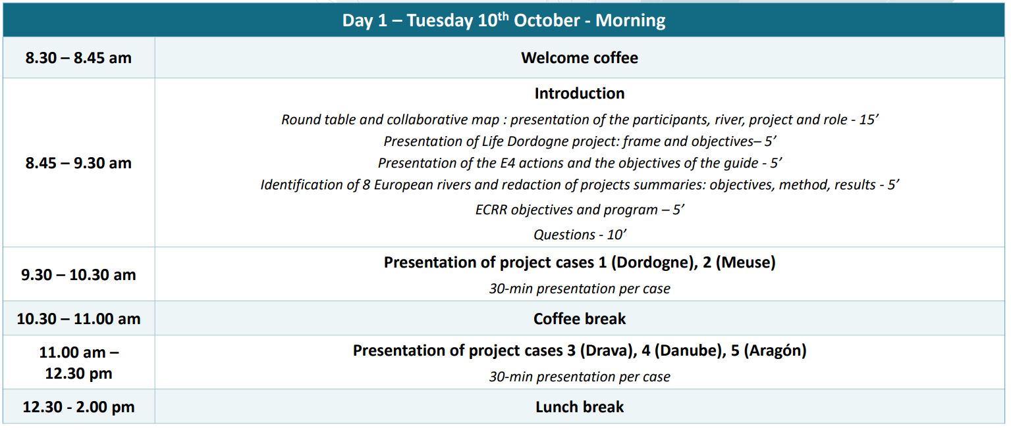
Agenda DAY 1

Slide 15
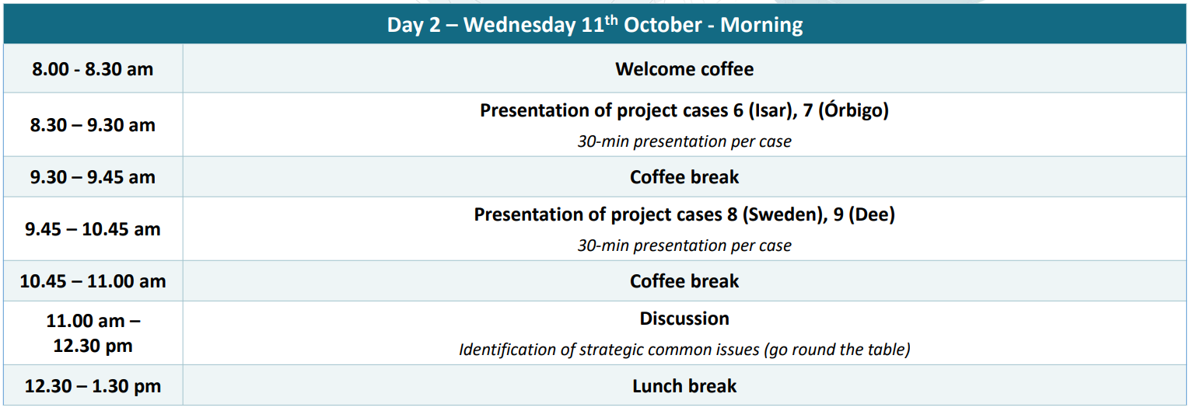
Agenda DAY 2

Slide 16
Results key TOPICS
1. Land ownership/acquisition: how to restore a connected river corridor at large scale? Which alternatives to land acquisition? Which administrative and financial tools are available?
2. Restoring lateral connectivity for flood risk mitigation
3. River restoration vs climate change: how does it influence the implementation/outcome of restoration projects?
4. How to ensure long-term monitoring of restoration?
5. The time dimension in morphological restoration
6. The role of (private) stakeholders: framework for involvement, financing, synergies
7. Regulatory drivers for restoration
8. River restoration vs conservation status of habitats and species
9. Morphological restoration effects on water quality?

Slide 17
Results key TOPICS selected
1. Land ownership/acquisition: how to restore a connected river corridor at large scale? Which alternatives to land acquisition? Which administrative and financial tools are available?
2. Restoring lateral connectivity for flood risk mitigation
3. River restoration vs climate change: how does it influence the implementation/outcome of restoration projects?
4. How to ensure long-term monitoring of restoration?
5. The time dimension in morphological restoration
6. The role of (private) stakeholders: framework for involvement, financing, synergies
7. Regulatory drivers for restoration
8. River restoration vs conservation status of habitats and species
9. Morphological restoration effects on water quality?

Slide 18
Results key POINTS OF EACH TOPIC
1. Land ownership/acquisition: | 6. The role of (private) stakeholders: | 8. River restoration vs conservation status of habitats and species
Land management agreement 5 years applicable to a wide range of actions | Cooperation with HPPs; legal obligation to put gravel each year | Restoring processes vs preserving existing habitats
land exchange facilitated by public body or within a project linked to rights not to lose land, more difficult outside the project | Discussion group with scientists, role as referee, scientists influence the technical choice of the HPPs | Restoration of specific habitats versus promotion of dynamics and diversity
Expropriation, long not popular | Possible cooperation between water supply company and water quality | How can the benefits of biodiversity be valued in the face of the problems most clearly perceived by the population?
Preemption gives priority for environmental objectives only when there is a sale | Evidence of water quality following river restoration: partner with drinking company supply in side arm, reconnection side arm to fill up the groundwater water self purification (data availability) + scientific study upcoming | Protected species in Natura 2000 sites: developing a management plan that takes into account river dynamics, discussing a vision helps to prioritise protected species and dynamics.
Allocate economic value to river with ES or fishing rights, payment for ES not long term ex water quality | Stakeholder with no lobbying power, individual owner as an important owner | Case by case basis, (for. E.g.) Freshwater pearl mussel restore and put them back
Exemption of tax on N2000 sites |  | Change the regulation for funding European project targeting species or habitats
There was not enough time to discuss all the issues and they can be further explored in future collaborations.

Slide 19
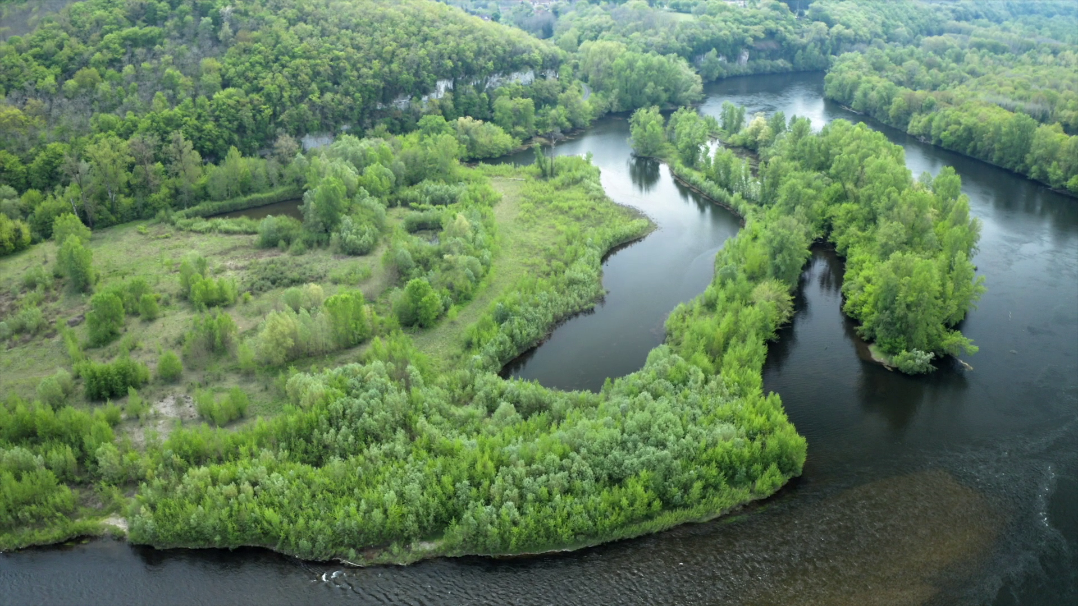
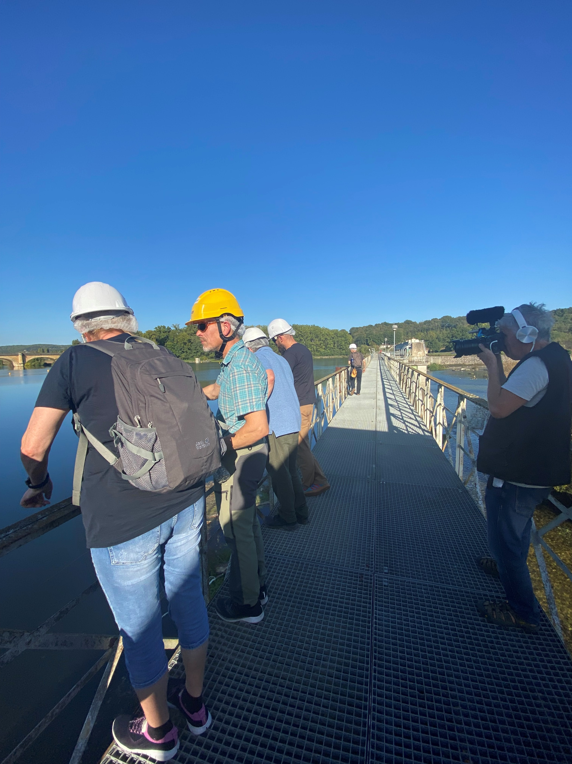
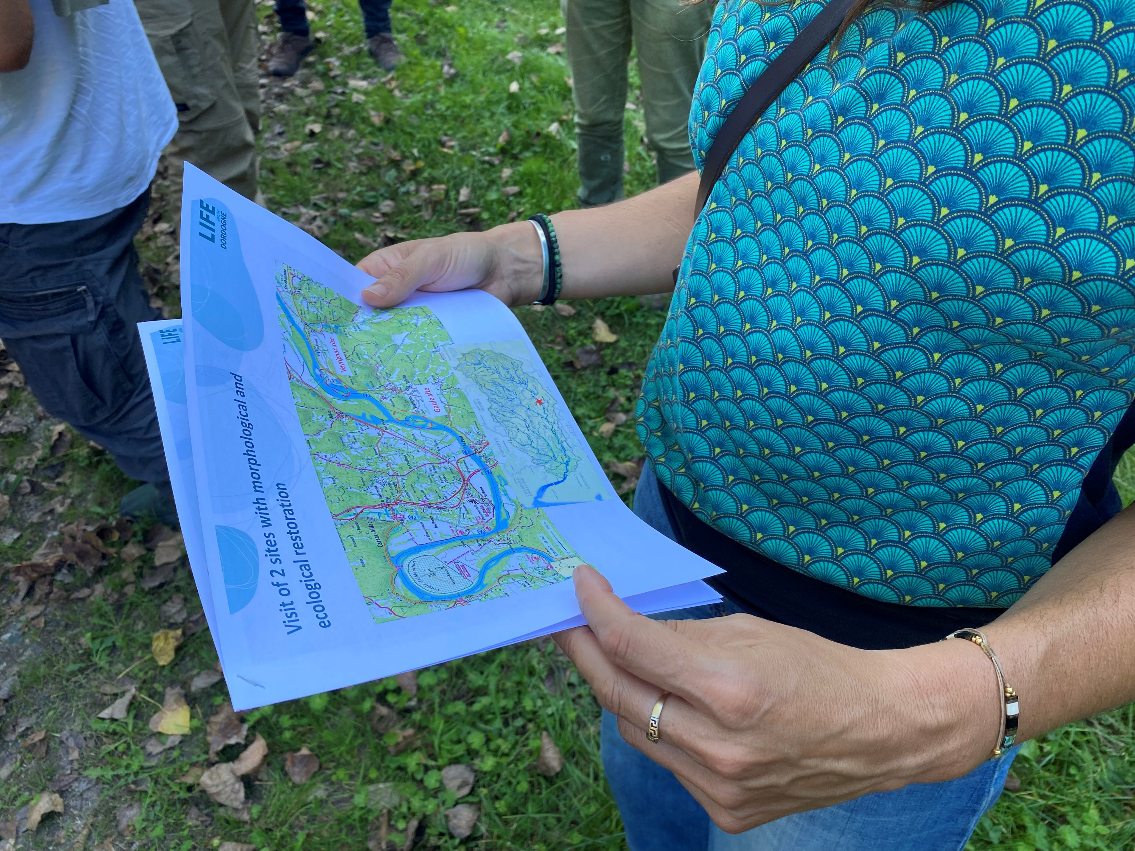
Field visits VEYRIGNAC, GAULE AND MAUZAC
Mauzac dam:
Example of sediment management project
Veyrignac and Gaule:
Example of a fluvial restoration of a site in the Dordogne

Slide 20
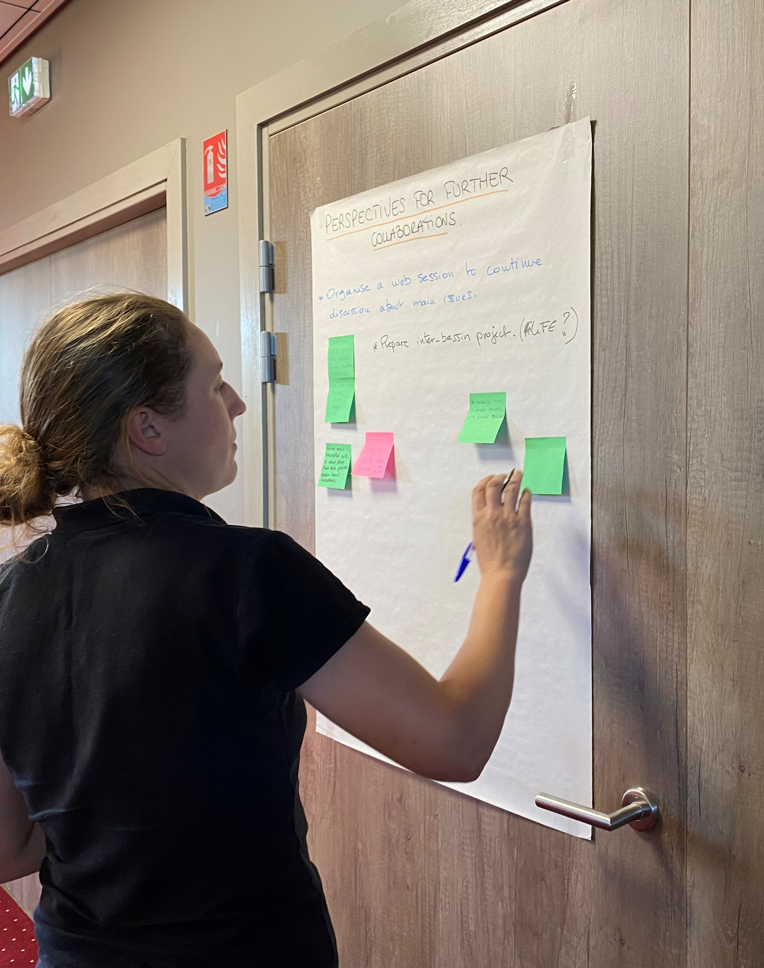
Ideas for the future
ADVICE FOR THE DORDOGNE RIVER LIFE PROJECT | PERSPECTIVES FOR FURTHER COLLABORATIONS | IDEAS FOR THE STUDY TOUR
Co-working with stakeholders | Regular information and discussion sessions (online Jour-fix, shared cloud storage, e-newsletter) | Itinerant canoeing study tour with outdoor activities (walking, fishing, birdwatching…)
Give information about the results and the positive impacts on biodiversity and water quality | Prepare an inter-basin project (LIFE ?) | Meetings and discussion with stakeholders, scientists, local people
Have a holistic vision and keep the catchment focus | Visits of the 8 case studies sites and of other similar projects with similar problems | Participation to monitoring actions
Don’t forget the social aspects and use creativity to connect with people (cinema activities, night tours, poetry, etc.)

Slide 21
CONCLUSIONS
RIVER EDUCATION: In general, there is a major concern about river education and communication: what and how can we address it to make it effective?
SOCIAL ACCEPTANCE: how to make stakeholders in society better understand river restoration projects and feel called upon to participate
LAND OWNERSHIP AND ACQUISITION: the importance of compiling the best ideas on how to deal with land purchases
KEEPING IN TOUCH!: keep in touch with the European river managers of the projects to learn more from their experiences and how we can improve
Life Dordogne Guide:
WHAT’S NEXT?

Slide 22
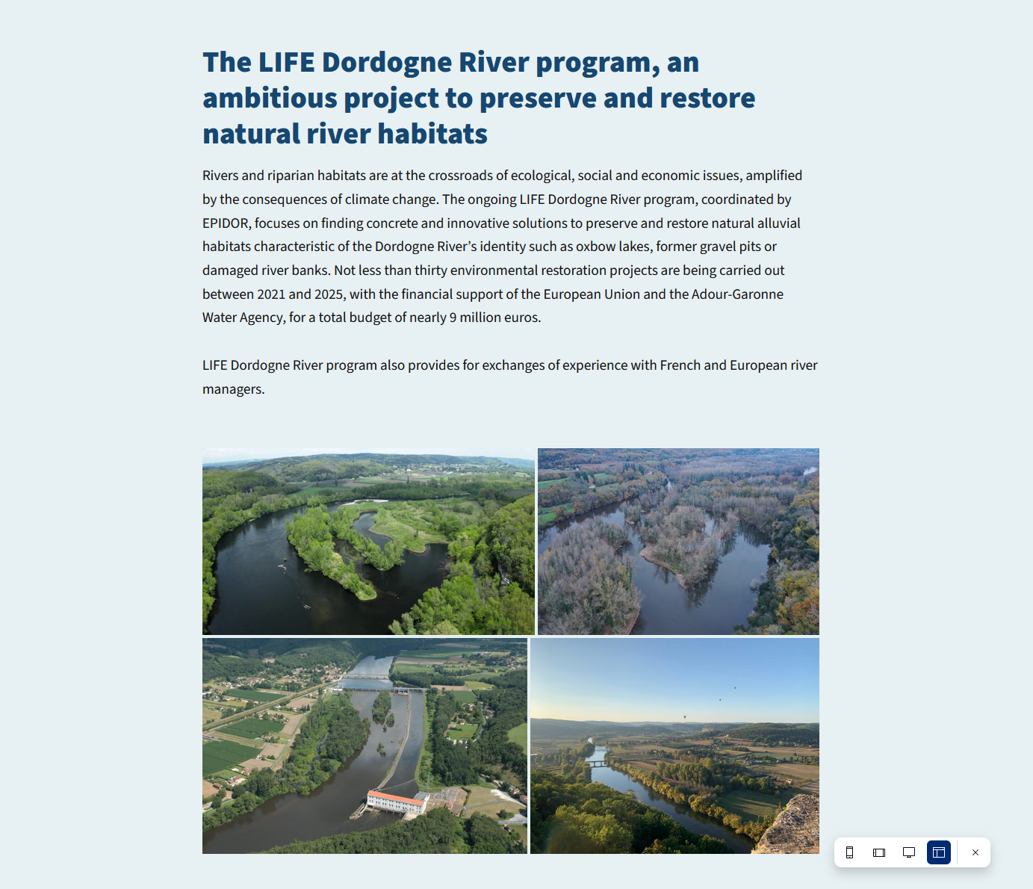
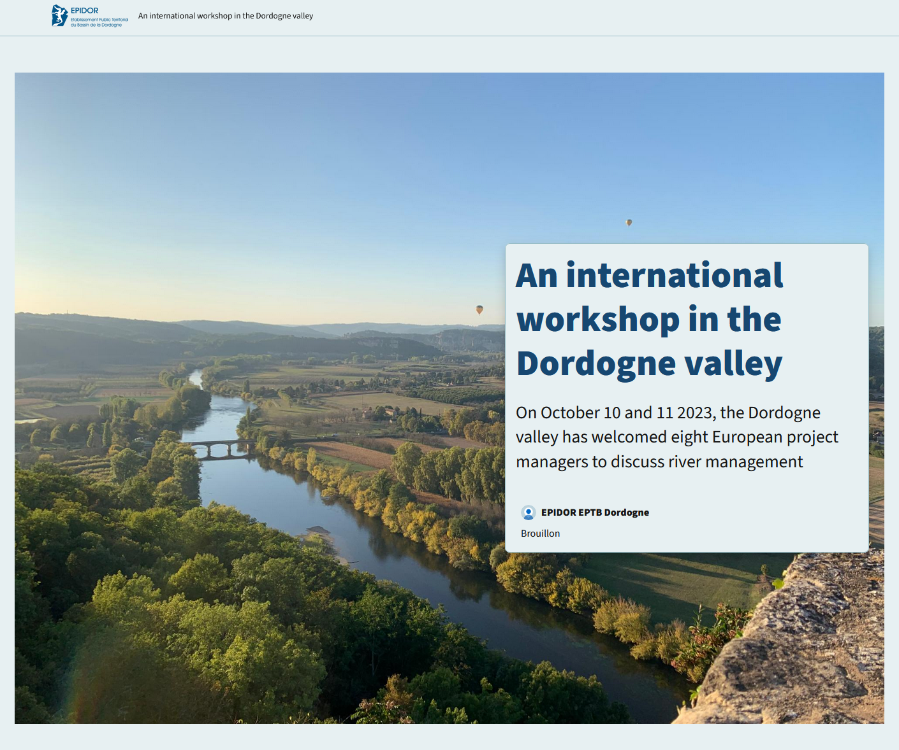
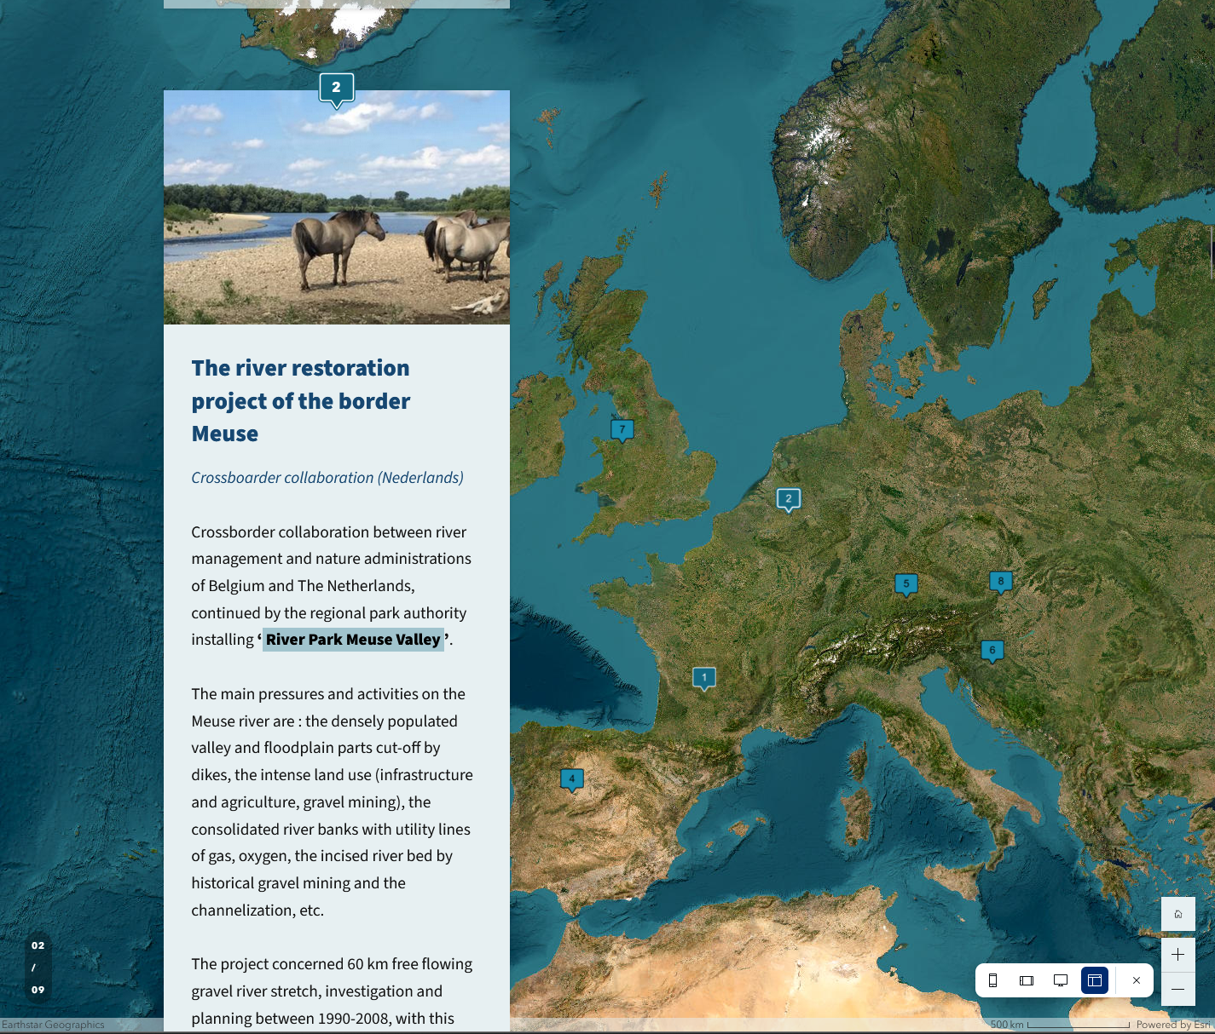
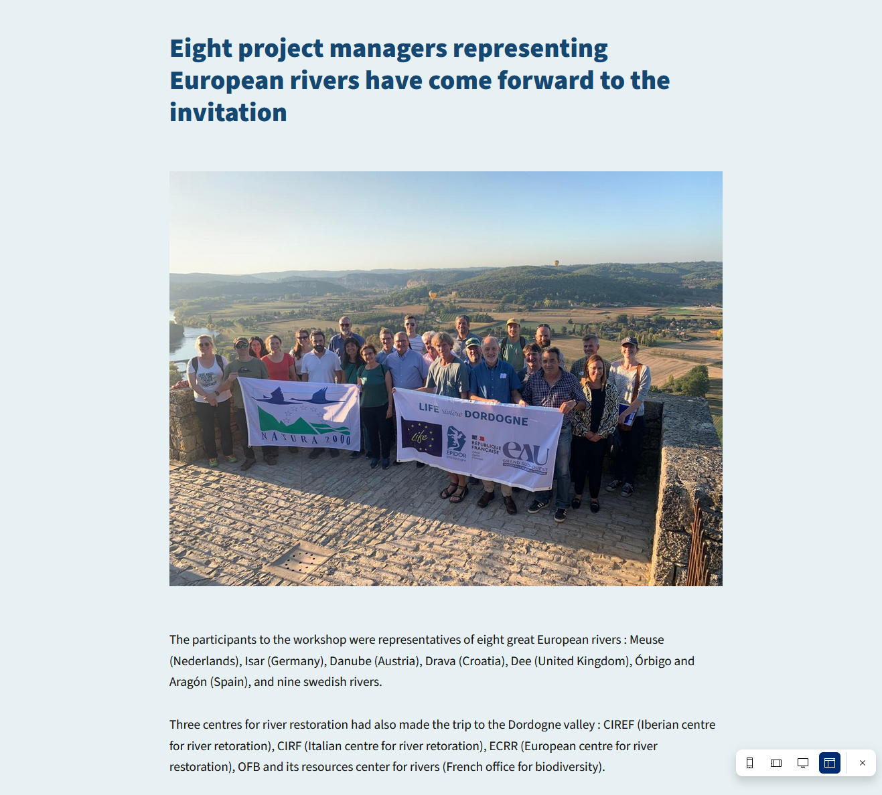
Showing the 8 rivers and THE RESULTS OF THE WORKSHOP

Slide 23
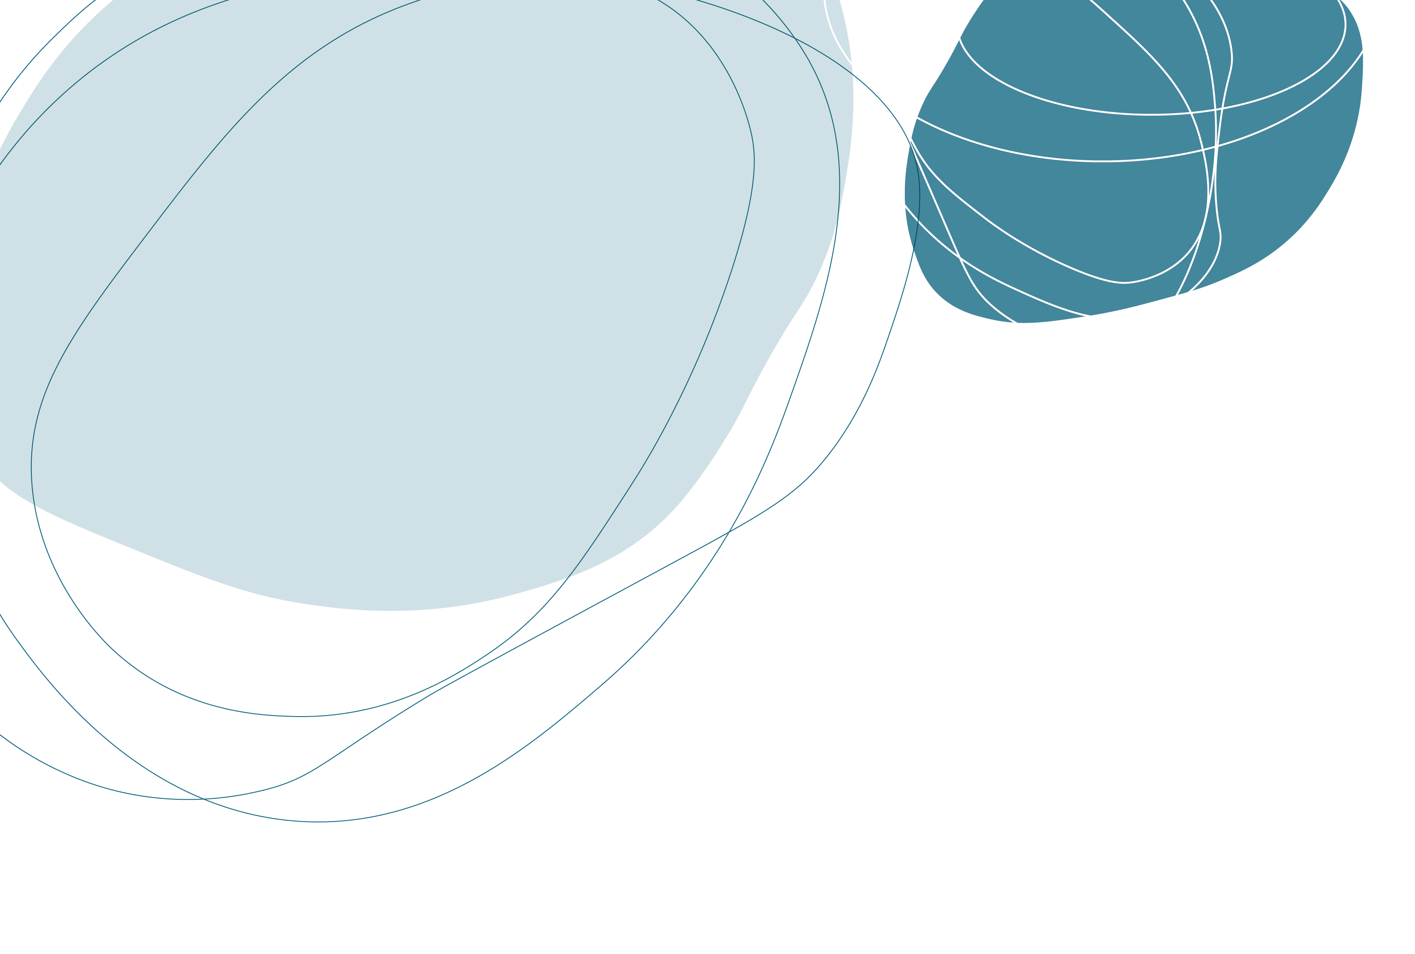
Le projet LIFE rivière Dordogne bénéficie du soutien financier de l’Union Européenne et de l’Agence de l’eau Adour-Garonne
LIFE DORDOGNE INTERNATIONAL WORKSHOP
10-11 October 2023 – Perigord – France

